Slide 1

What is Sequencing?
Sequencing refers to the process of arranging information, events, or actions in a specific, logical order. This concept is fundamental in various fields, including biology, literature, computer science, and education, where understanding the correct sequence of events or steps is essential for achieving desired outcomes.

Slide 2

Types of Sequencing:
1. Temporal Sequencing (Chronological Order):
This involves placing events in the order they occurred over time. For instance, when telling a story or recounting historical events, sequencing helps to maintain a coherent narrative, allowing the audience to follow the progression of events logically.

Slide 3

Sequential Logic in Computer Science
- In programming, sequencing is the order in which instructions or commands are executed. It is crucial because the outcome of a program or algorithm depends heavily on the correct sequence of operations. If steps are out of order, the program might not work as intended.

Slide 4
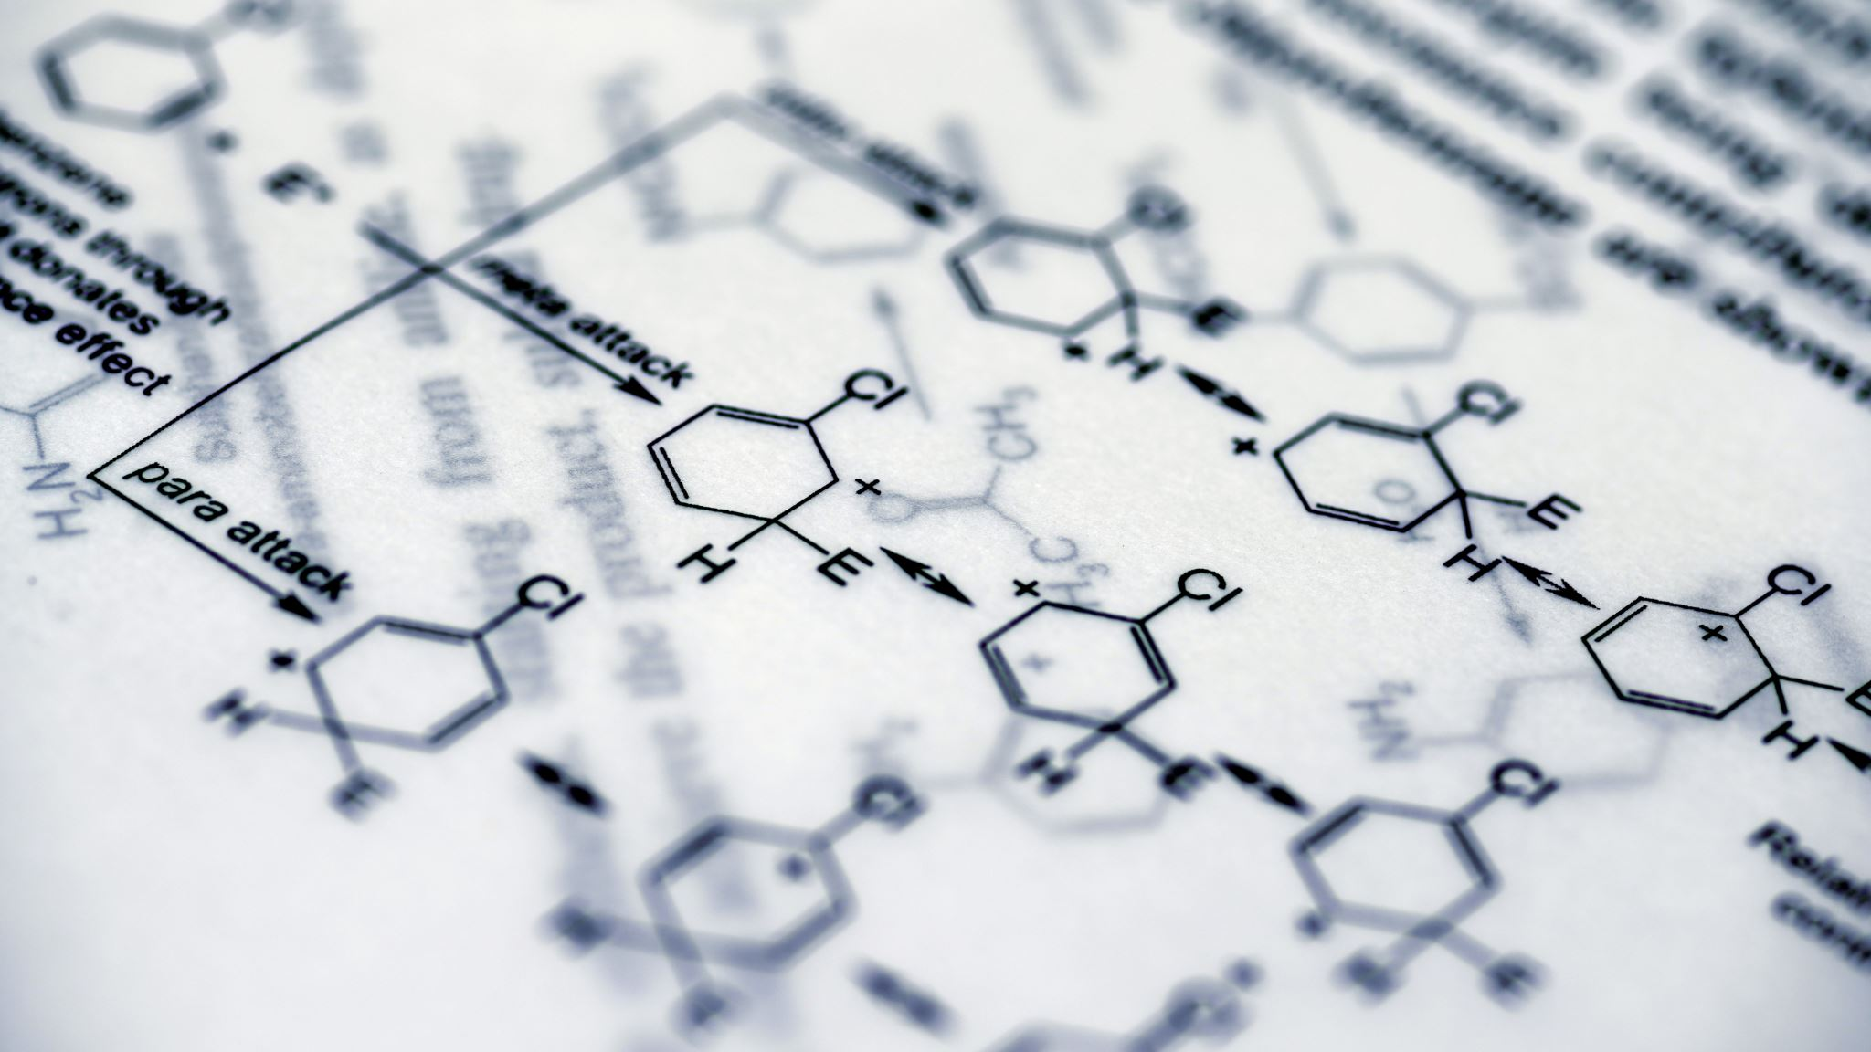
Biological Sequencing
In genetics, sequencing refers to determining the exact order of nucleotides within a DNA molecule. This order is vital because it carries the genetic information that dictates how organisms develop, function, and reproduce.

Slide 5
Educational Sequencing
- In education, sequencing involves organizing learning activities or curriculum content in a way that builds knowledge progressively. For example, in a math curriculum, students might first learn basic arithmetic before moving on to more complex topics like algebra or calculus.

Slide 6

Importance of Sequencing
Clarity and Comprehension: Proper sequencing ensures that information is presented in a way that is easy to follow and understand. This is critical for effective communication, whether in writing, speaking, or teaching.

Slide 7
Efficiency
In tasks that require multiple steps, sequencing helps in completing them efficiently and without errors. For example, following the correct sequence in a recipe ensures that the dish turns out as expected.

Slide 8

Problem-Solving
Sequencing aids in breaking down complex problems into smaller, manageable steps, making it easier to tackle and solve them.

Slide 9

Examples of Sequencing
Literary Sequencing: In a novel, sequencing the plot events correctly is essential for maintaining narrative flow and reader engagement. Flashbacks or foreshadowing are techniques that play with sequencing to create suspense or deepen understanding.

Slide 10
DNA Sequencing
DNA Sequencing: Scientists use sequencing to map out genomes, which helps in identifying genes, understanding genetic disorders, and developing treatments.

Slide 11
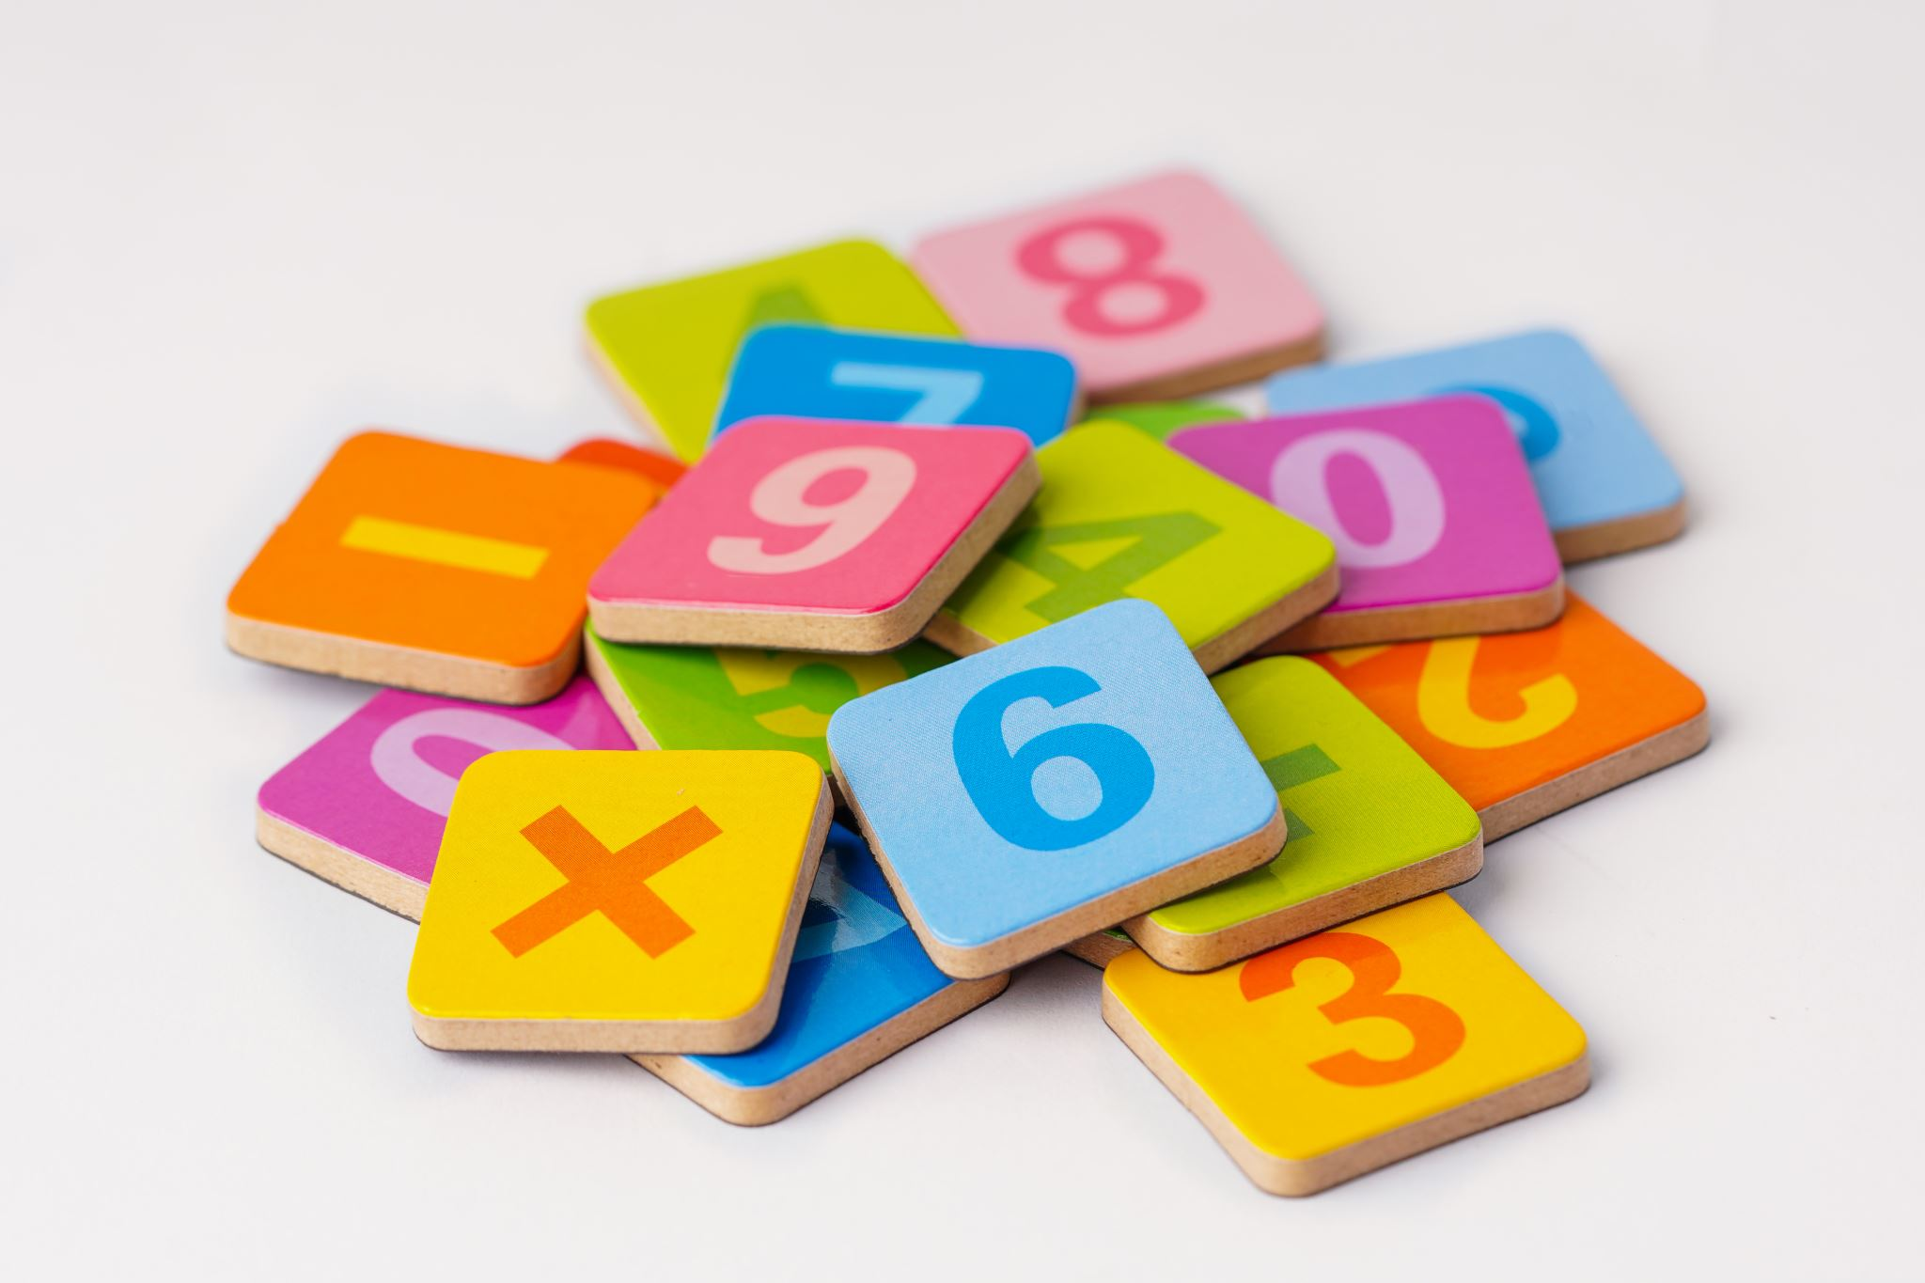
Summary
Sequencing is about the logical arrangement of information, actions, or events. Whether in storytelling, scientific research, or daily activities, understanding and applying correct sequencing is crucial for success and coherence.

