Slide 1
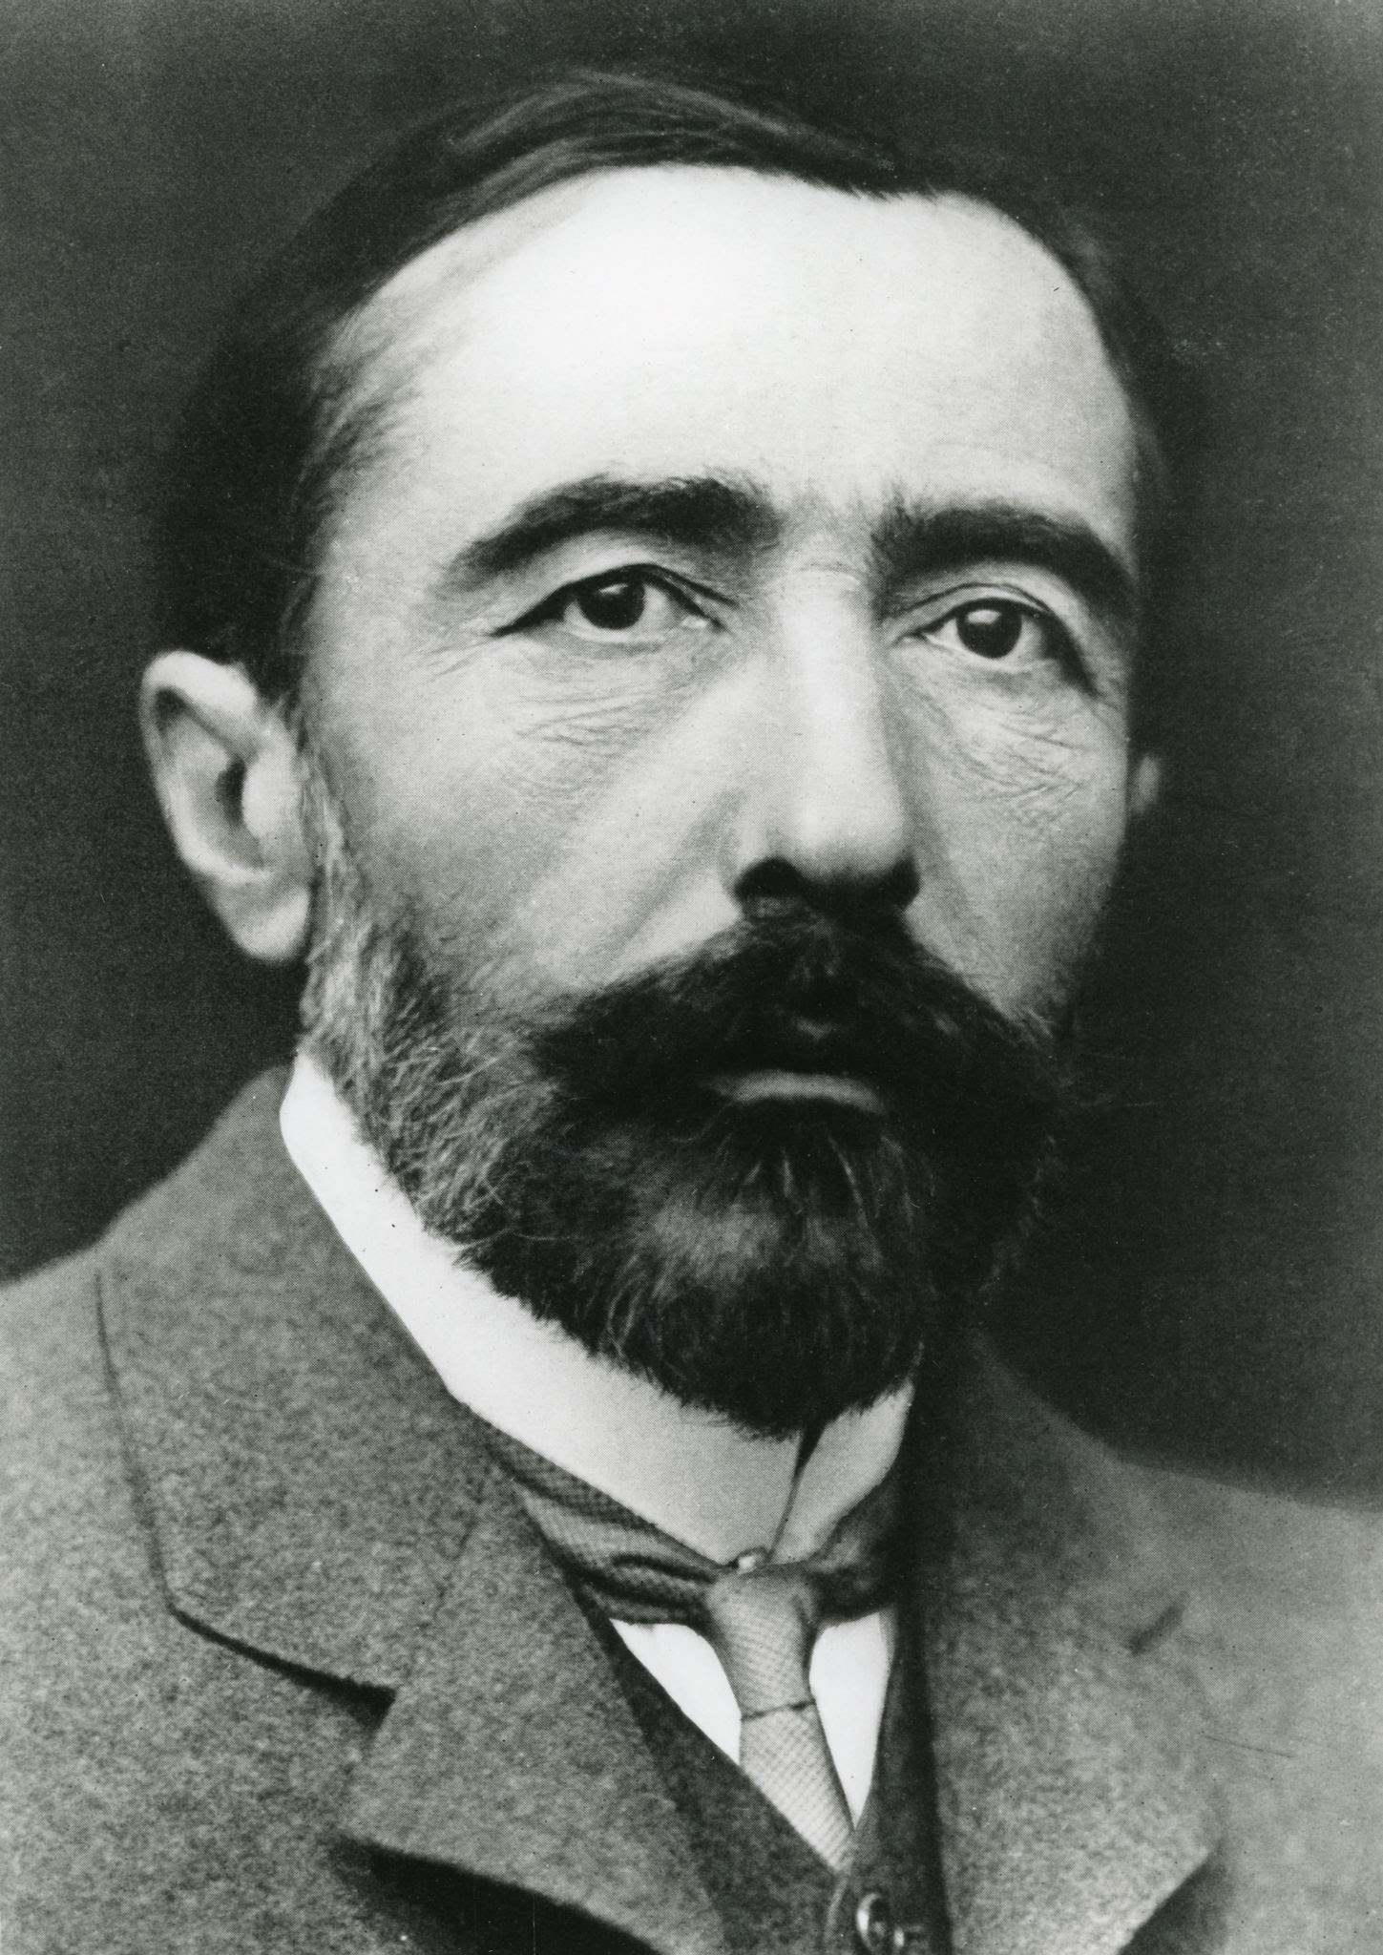
Heart of Darkness
Author: Joseph Conrad (1857-1924) was a British-Polish novelist and story writer.[
Publication: First published in 1899 as a serial; book format in 1902.
Setting: Primarily set on the Congo River in Africa during European colonial rule.
Genre: Novella; classified as a modernist text.

Slide 2
Plot Summary
Charles Marlow, a sailor and narrator, as he recounts his journey into the African Congo to find Kurtz, an ivory trader of legendary reputation.
Journey Stages:
Departure from Europe
Encountering the brutal reality of colonialism in Africa
Discovery of Kurtz and the unravelling of his complex character

Slide 3
Chief Characters
Charles Marlow: Protagonist and reflective narrator.
Kurtz: An ivory trader who becomes consumed by power and greed; embodies moral corruption.
The Intended: Kurtz’s fiancée, representing naivety and the idealized view of colonialism.
Manager and Other Agents: Symbolize bureaucratic inefficiency and exploitation.

Slide 4

Themes in Heart of Darkness
Imperialism and Colonial Exploitation:
Critiques the dehumanizing effects of European colonialism.
The façade of “civilizing missions” contrasted with brutal realities.
Good vs. Evil:
Exploration of inherent human savagery and the thin veneer of civilization.
Alienation and Isolation:
Marlow’s psychological journey mirrors Kurtz’s isolation and descent.
Darkness as a Symbol
Represents both literal and metaphorical darkness (ignorance, evil).

Slide 5
Symbolism in the Novel
The Congo River: Both a means of connection and separation; represents Marlow’s journey into the heart of darkness.
Fog: Signifies uncertainty and moral ambiguity.
Kurtz’s Last Words (“The horror! The horror!”): Reflects his realization of the atrocities committed and the darkness within.
Light vs. Darkness
Explores the duality of civilization and savagery.

Slide 6
Narrative Style and Structure
Frame Narrative: Story within a story, adding layers to Marlow’s retelling.
Ambiguity and Unreliable Narration
The narrative questions the distinction between truth and perception.
Symbolic Imagery and Descriptive Language:
Conrad’s use of vivid imagery emphasizes the novel’s themes.

Slide 7
Critical Reception and Interpretations
Initial Reception: Mixed responses; praised for literary style but criticized for its challenging themes.
Post-Colonial Critique:
Chinua Achebe’s Criticism: Called the novella racist for its portrayal of Africa as a mere backdrop to European concerns.
Modern Analysis: Seen as a critique of the destructive nature of imperialism and a study of the human psyche.

