Slide 1
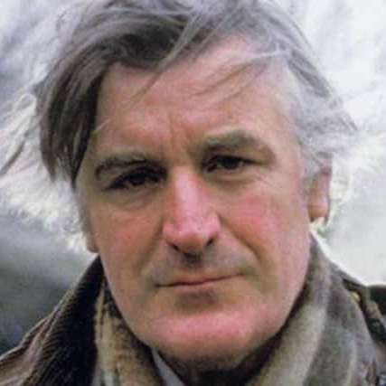
TED HUGHES (1930-1998)

Slide 2
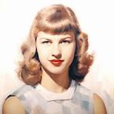
Private Life
Married Sylvia Plath (1932-1963).They had two children.
Later they separated, which may have contributed to the suicide of Plath in 1963

Slide 3
His Poetry
He was aware of violent forces of nature.
He wrote with great powers of imagination.
His writing was very cynical, written in rough, harsh, sometimes disjointed lines, emphasizing the scheming and savagery of animal life.

Slide 4
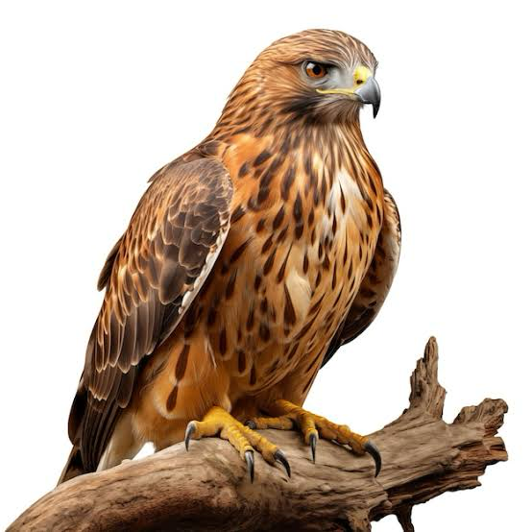
Hawk

Slide 5
HAWK ROOSTING
I sit in the top of the wood, my eyes closed.
Inaction, no falsifying dream
Between my hooked head and hooked feet:
Or in sleep rehearse perfect kills and eat.
The convenience of the high trees!
The air's buoyancy and the sun's ray
Are of advantage to me;

Slide 6
HAWK ROOSTING
And the earth's face upward for my inspection.
My feet are locked upon the rough bark.
It took the whole of Creation
To produce my foot, my each feather:
Now I hold Creation in my foot
Or fly up, and revolve it all slowly -
I kill where I please because it is all mine

Slide 7
HAWK ROOSTING
There is no sophistry in my body:
My manners are tearing off heads -
The allotment of death.
For the one path of my flight is direct
Through the bones of the living.
No arguments assert my right:
The sun is behind me.

Slide 8
HAWK ROOSTING
Nothing has changed since I began.
My eye has permitted no change.
I am going to keep things like this.
-------------

