Slide 1
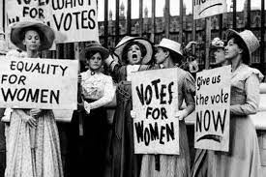
The Suffragette Movement

Slide 2

Introduction
Definition of suffrage: The right to vote in political elections.
Importance of the movement: A pivotal step in gender equality.
Overview: Time period (19th–20th centuries) and global significance.

Slide 3
Early Beginnings
Key events:
Seneca Falls Convention (1848)
Declaration of Sentiments by Elizabeth Cady Stanton.
Early challenges and opposition.

Slide 4
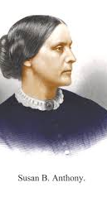
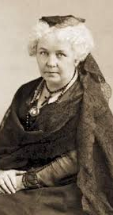
Key Figures
Elizabeth Cady Stanton: Writer and leader of the movement.
Susan B. Anthony:
Co-founder of the National Woman Suffrage Association (NWSA).

Slide 5
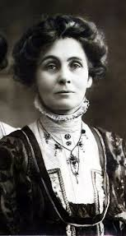
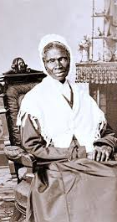
KEY FIGURE
Sojourner Truth: Advocate for both abolition and women’s rights.
Emmeline Pankhurst: Leader of the British suffragette movement.

Slide 6

Methods of Protest
Petitions and lobbying: Engaging lawmakers
Public demonstrations: Marches and parades.
Civil disobedience: Hunger strikes and sit-ins.
Publications: Newspapers and pamphlets advocating for rights.

Slide 7
Major Victories
United States: 19th Amendment (1920): Women’s right to vote.
United Kingdom: Representation of the People Act (1918, 1928).
Global impact: New Zealand as the first self-governing country to grant women the vote (1893).

Slide 8

Challenges and Opposition
Resistance from:
Governments and political institutions.
Societal norms and patriarchal attitudes.
Internal divisions within the movement.

Slide 9

Global Perspective
Timeline of women gaining suffrage worldwide.
Notable examples:
Australia (1902), India (1947), Switzerland (1971), Saudi Arabia (2015).

Slide 10

Impact of the Movement
Social changes: Women in leadership roles.
Influence on other rights movements: Civil rights and LGBTQ+ rights.
Ongoing struggles: Gender parity in politics.

Slide 11
Conclusion
Summary of achievements.
Legacy of the movement: Inspiring continued advocacy for equality.
Quote: “Courage calls to courage everywhere.” – Millicent Fawcett

