Slide 1
Delhi Sultanate
Architecture & Sculpture

Slide 2
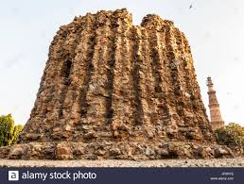
Alai Minar

Slide 3
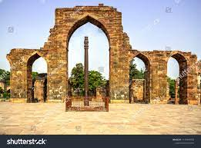
Qutub Minar Complex

Slide 4
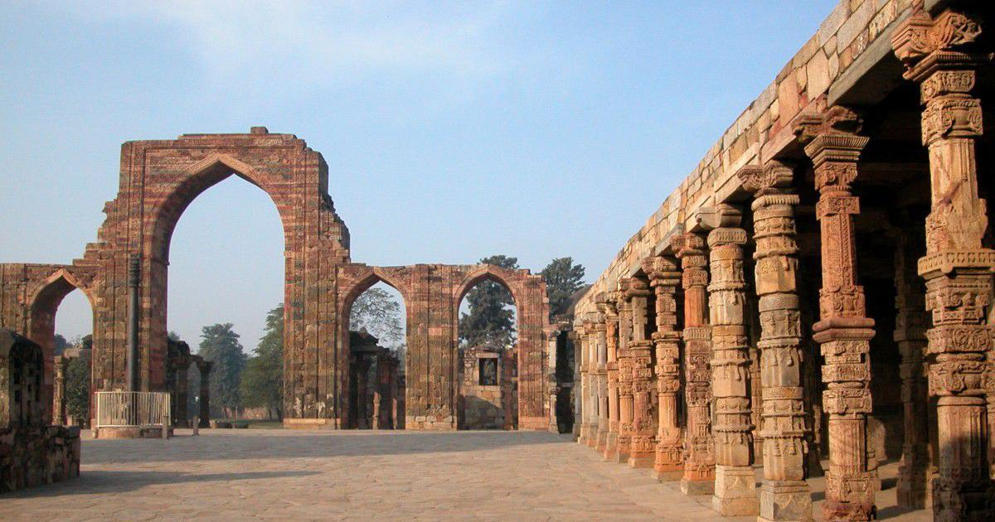
Qutub Minar Complex

Slide 5
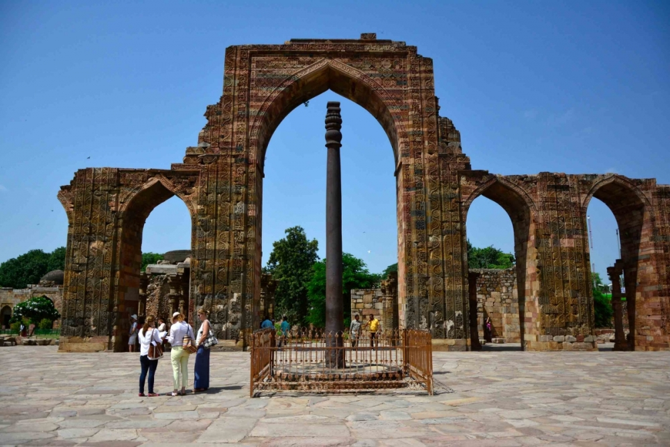
Qutub Minar Complex

Slide 6
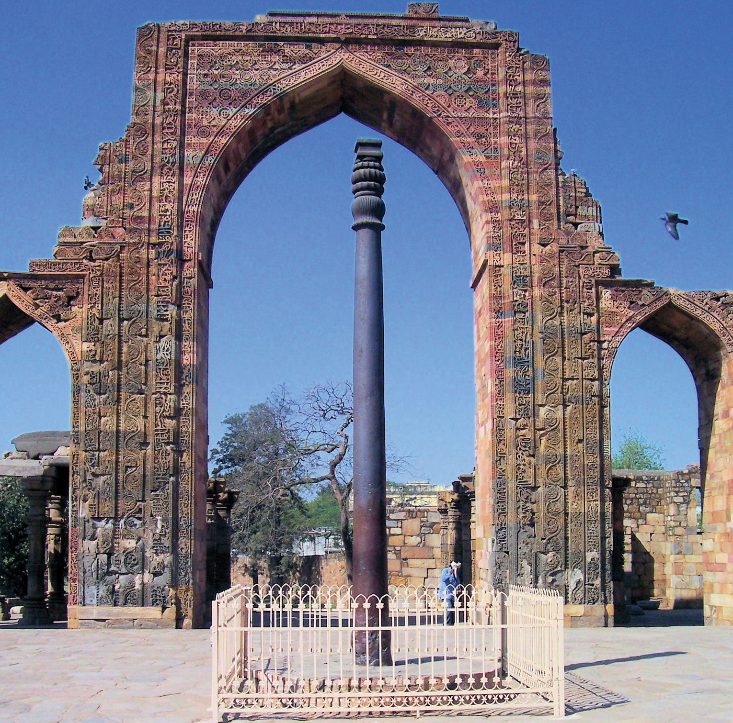
Iron Pillar of Mehrauli

Slide 7
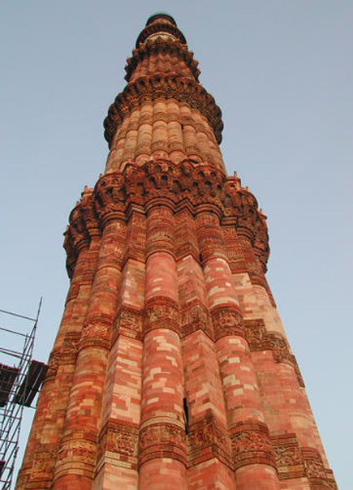
Qutub Minar

Slide 8
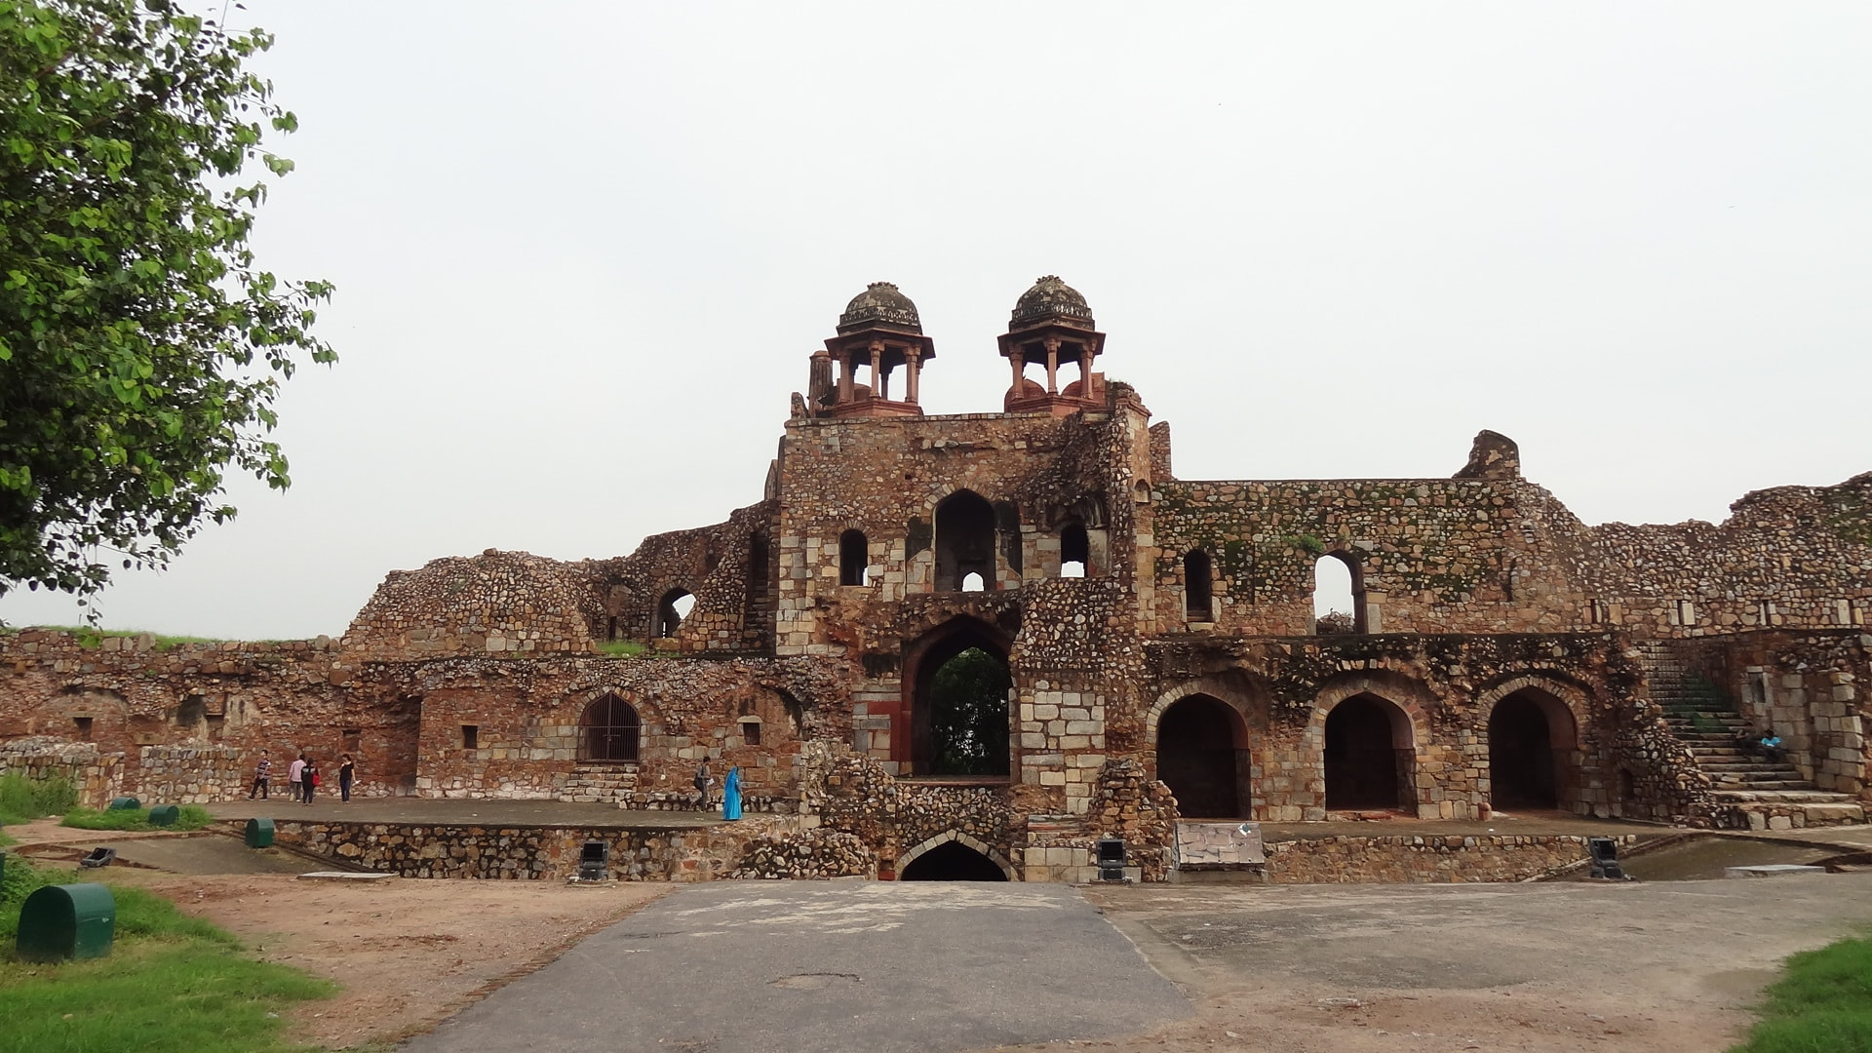
Siri Fort

Slide 9
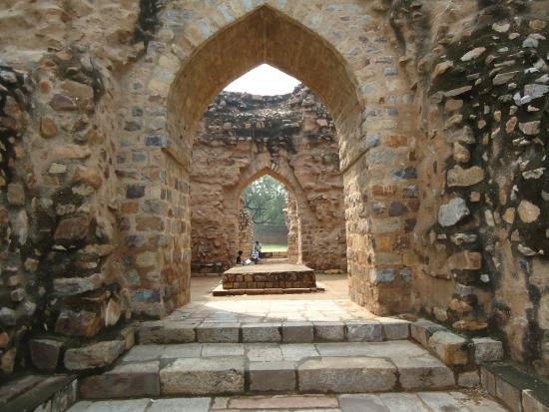
Tomb of Sultan Alauddin Khilji

Slide 10
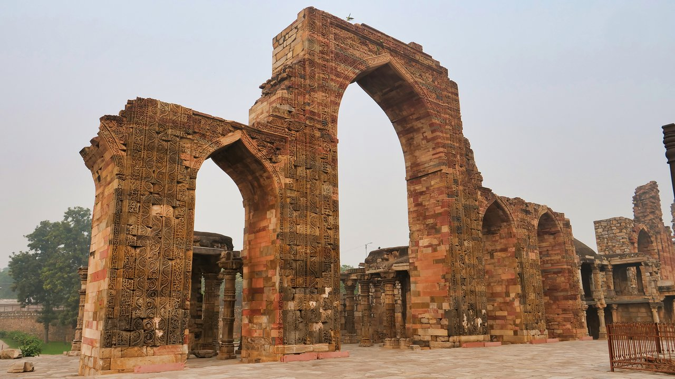
Quwwatul Islam Mosque

Slide 11
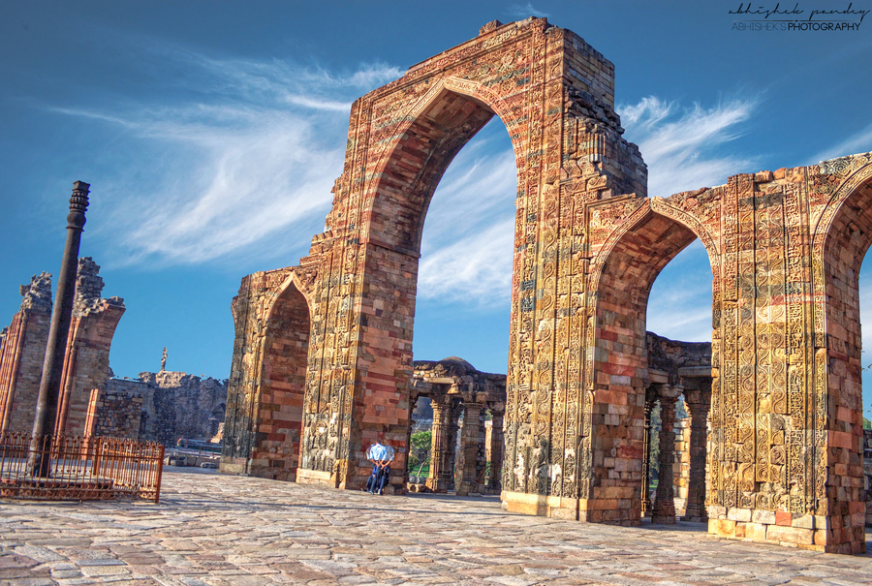
Quwwatul Islam Mosque

Slide 12
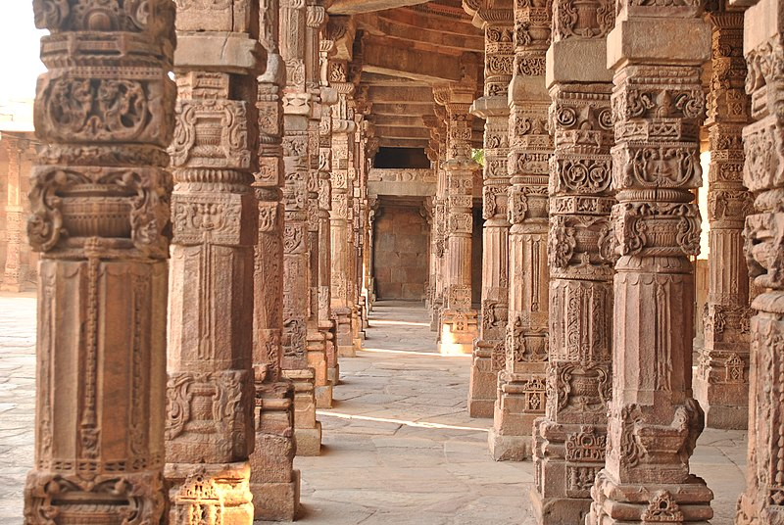
Interior of Quwwatul IslamMosque

Slide 13
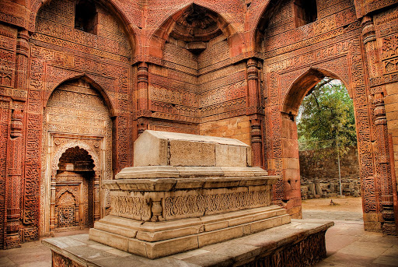
Tomb of Sultan Iltutmish

Slide 14
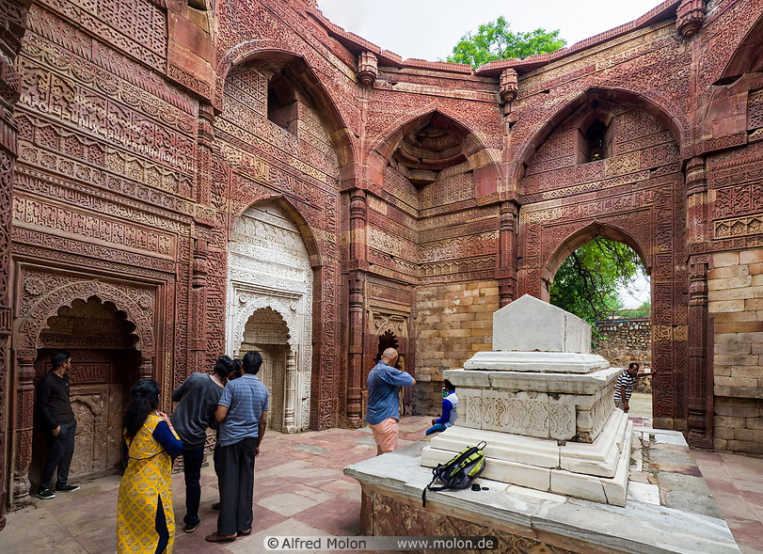
Tomb of Iltutmish

Slide 15
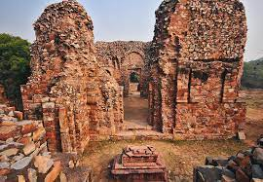
Tomb of Sultan GiyasuddinBalban

Slide 16
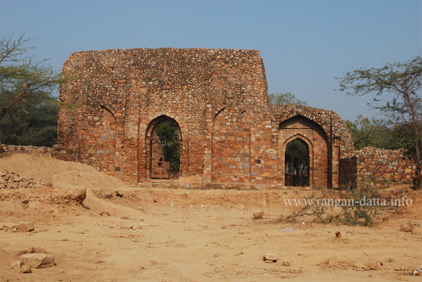
Tomb of Sultan Balban

Slide 17
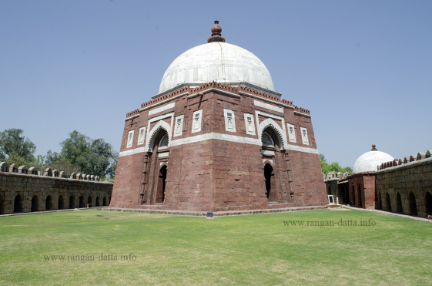
Tomb of Giyasuddin Tughlaq

Slide 18
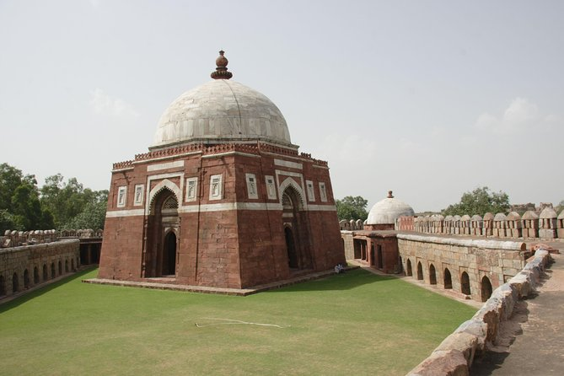
Tomb of Giyasuddin Tughlaq

Slide 19
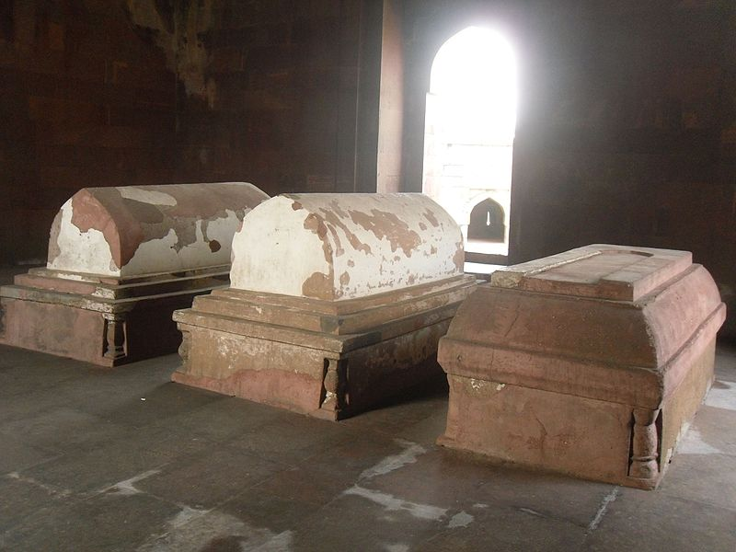
Interior of Maqbaras

Slide 20
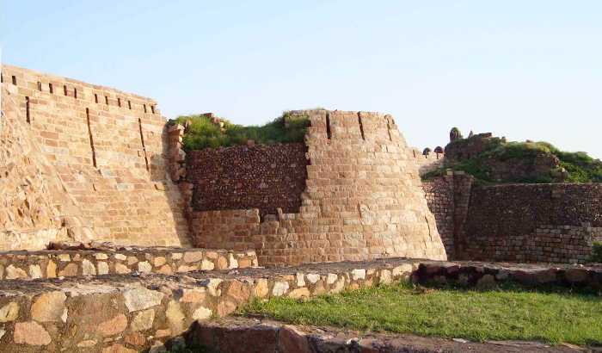
Tughlaqabad Fort

Slide 21
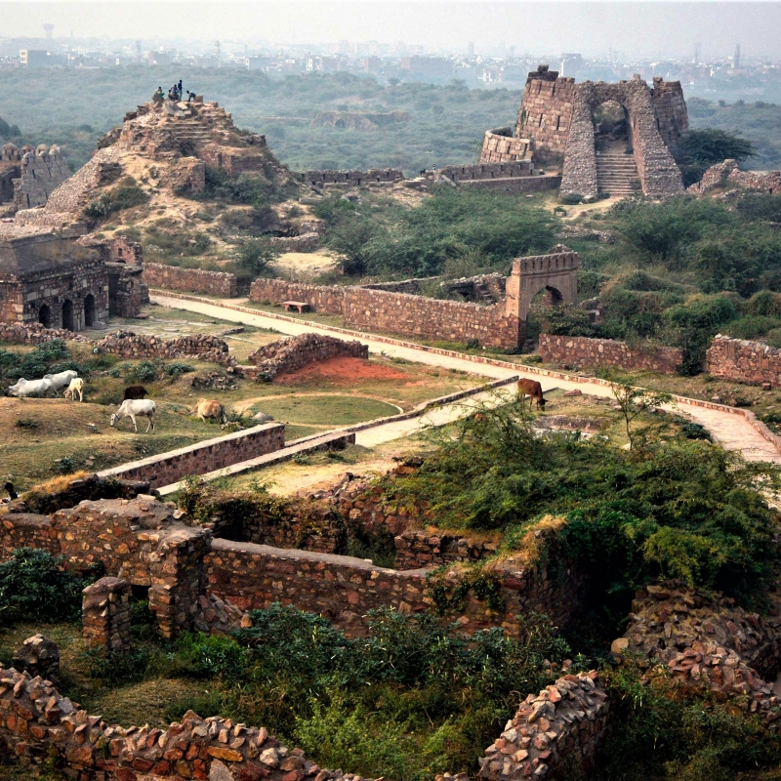
Tughlaqabad Fort

Slide 22
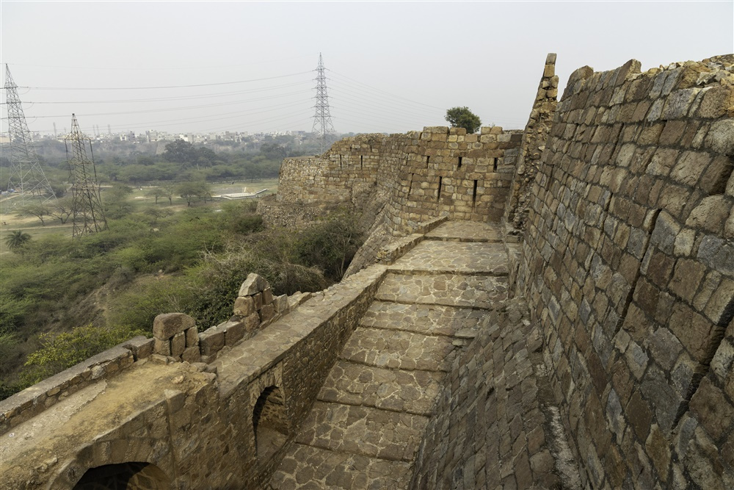
Adilabad Fort

Slide 23
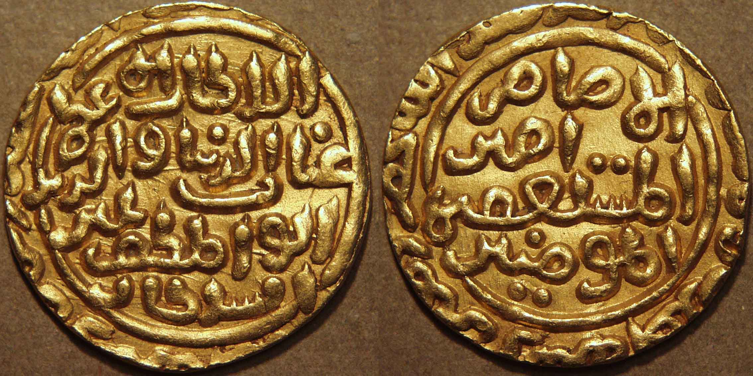
Copper Jittal of Delhi Sultanate

Slide 24
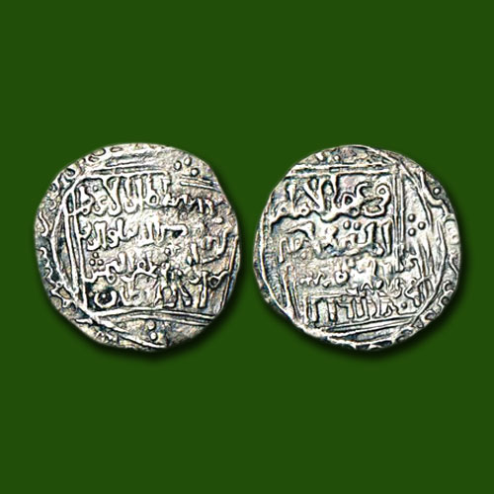
Silver Tanka

Slide 25
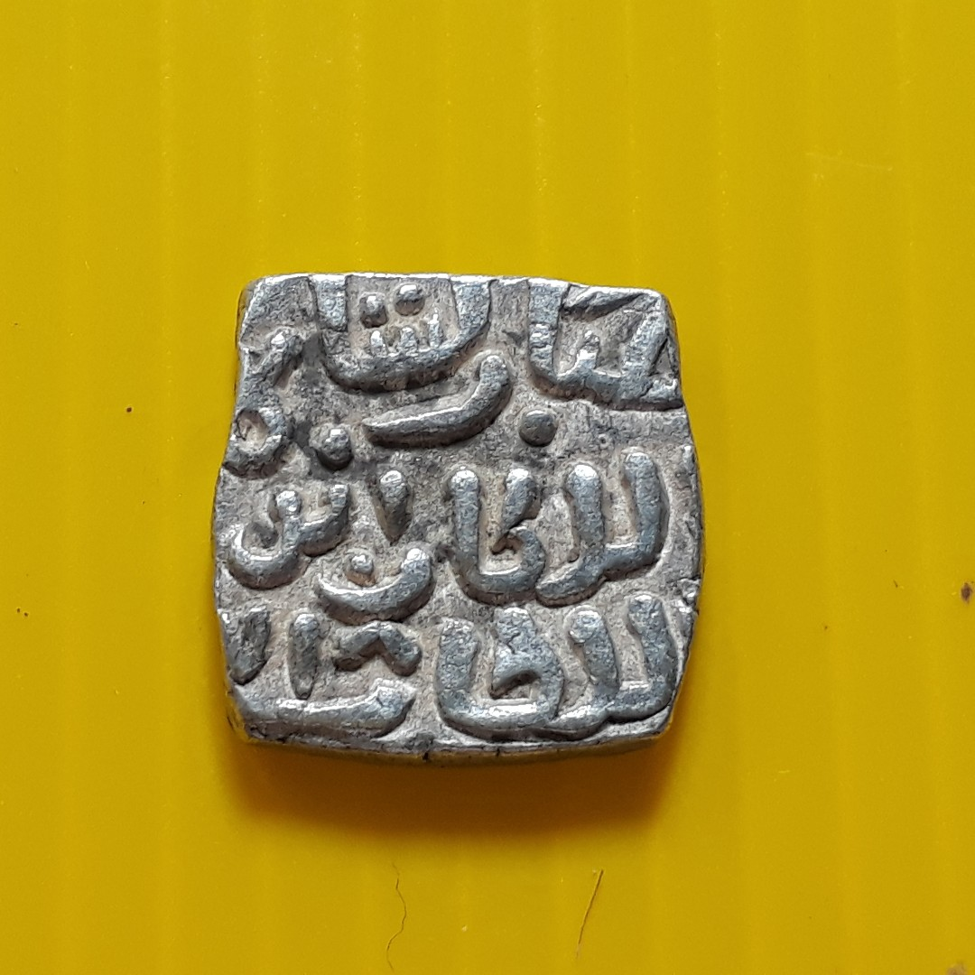
Coins of Mubarak Shah Khilji

Slide 26
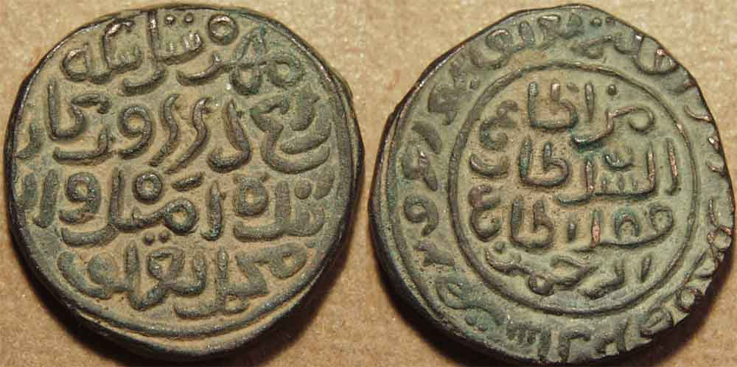
Bronze Coins of MBT

