Slide 1
Art & Architecture of Ancient India

Slide 2
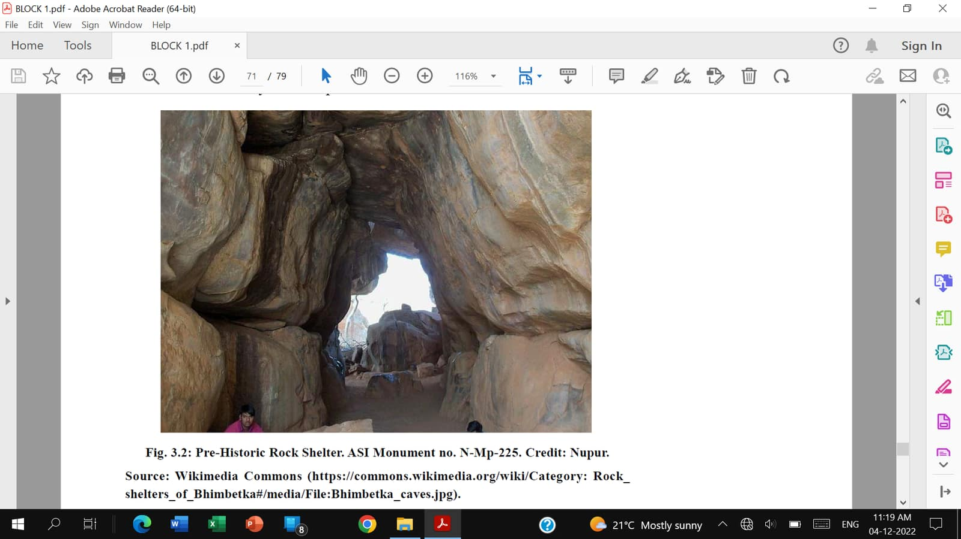
Pre-Historic Rock Shelter

Slide 3
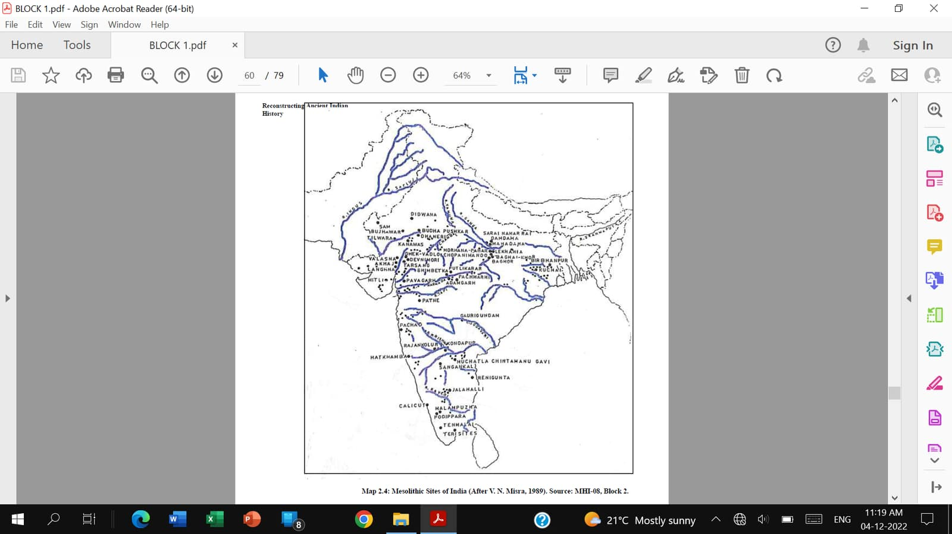
Mesolithic Sites of India

Slide 4
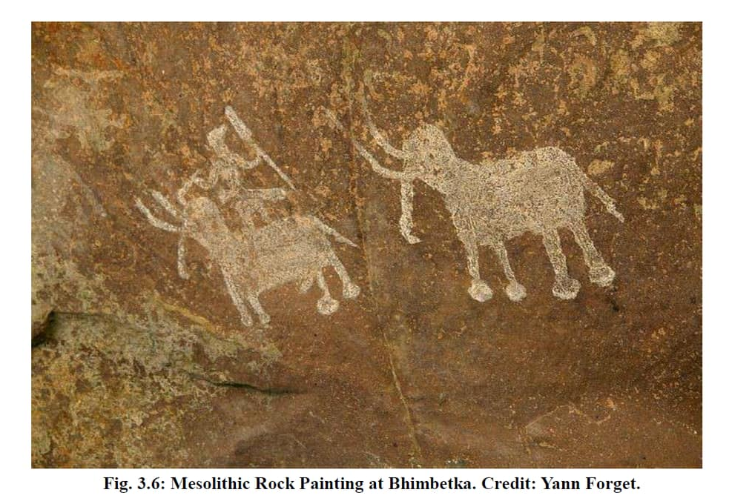
Mesolithic Painting: Bhimbetka

Slide 5
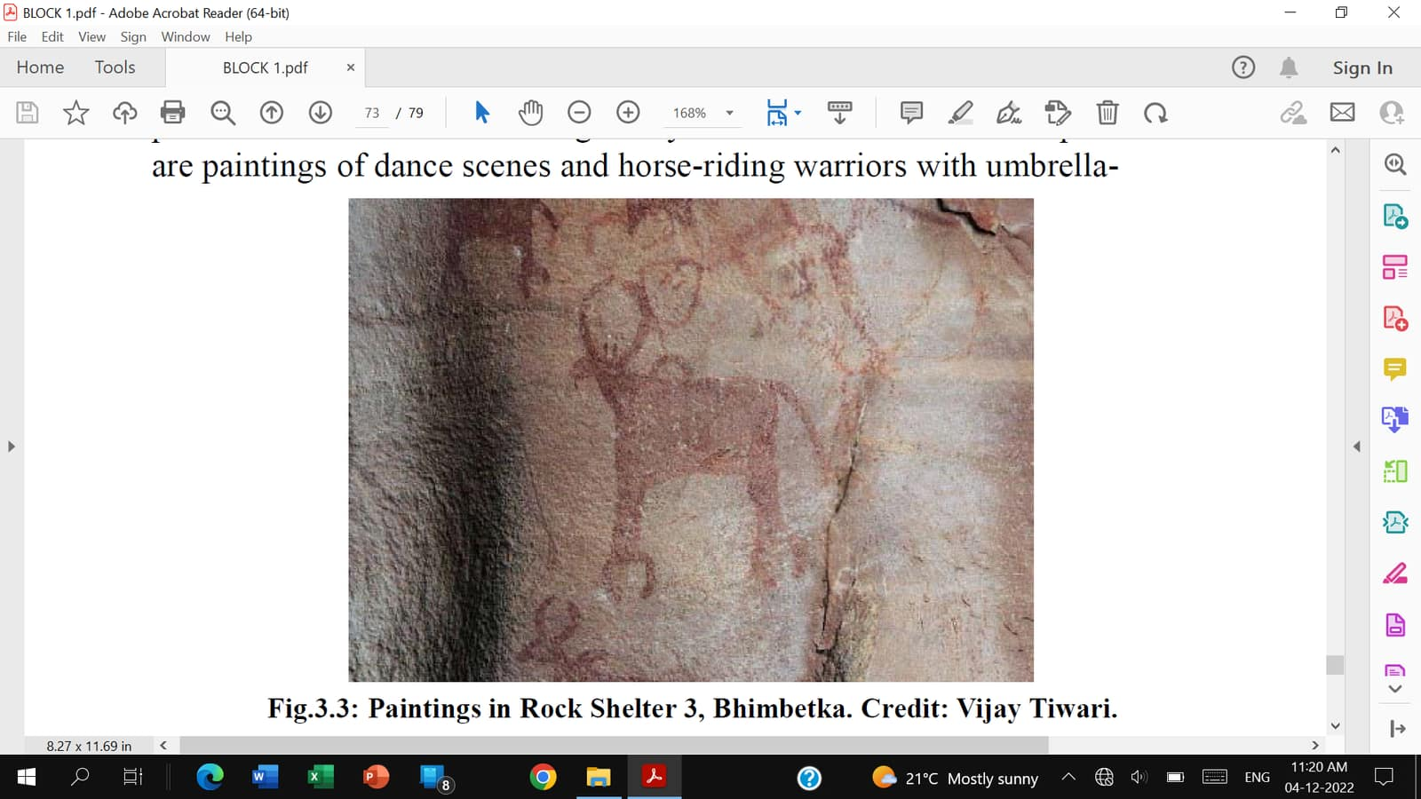
Rock Painting: Bhimbetka

Slide 6
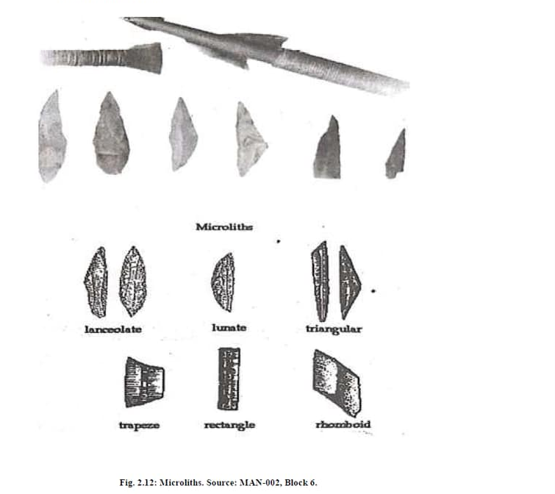
Microlithic Tools

Slide 7
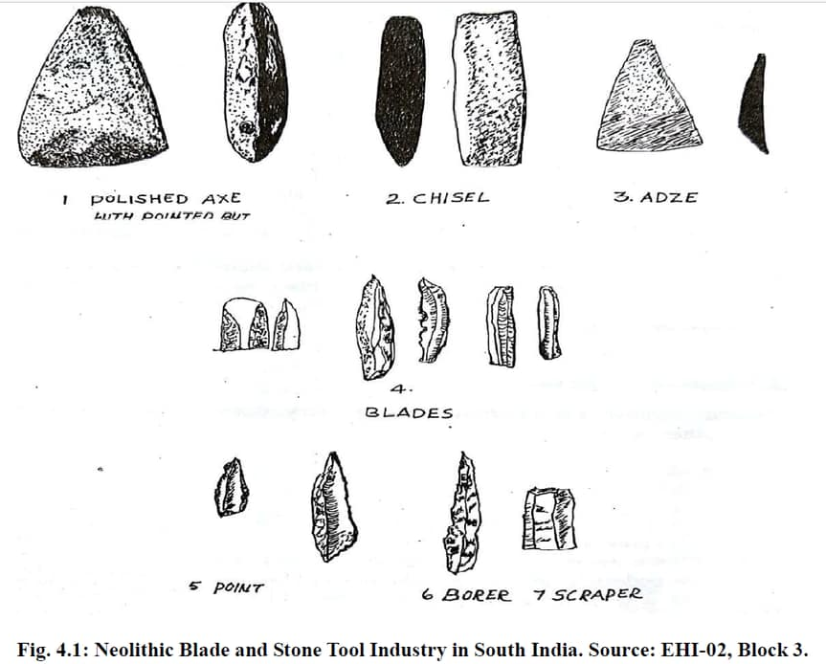
Neolithic Tools

Slide 8
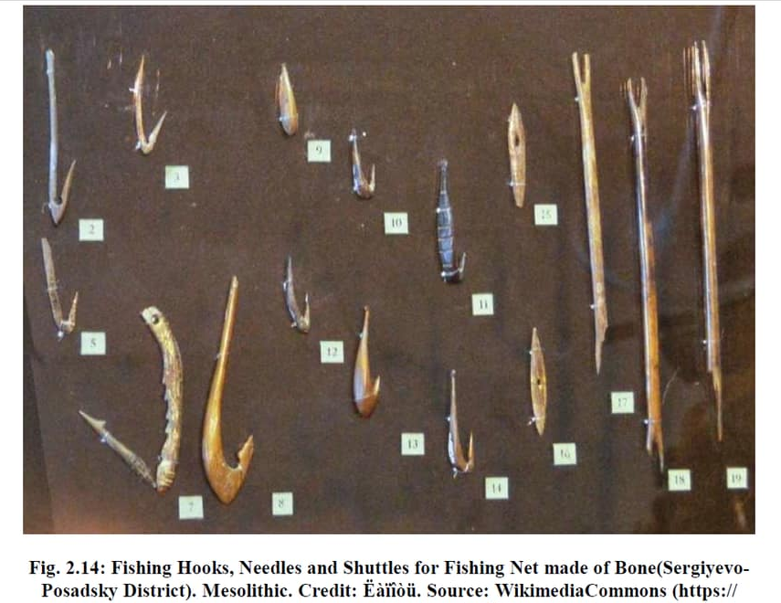
Fishing Hooks: Neolithic Age

Slide 9
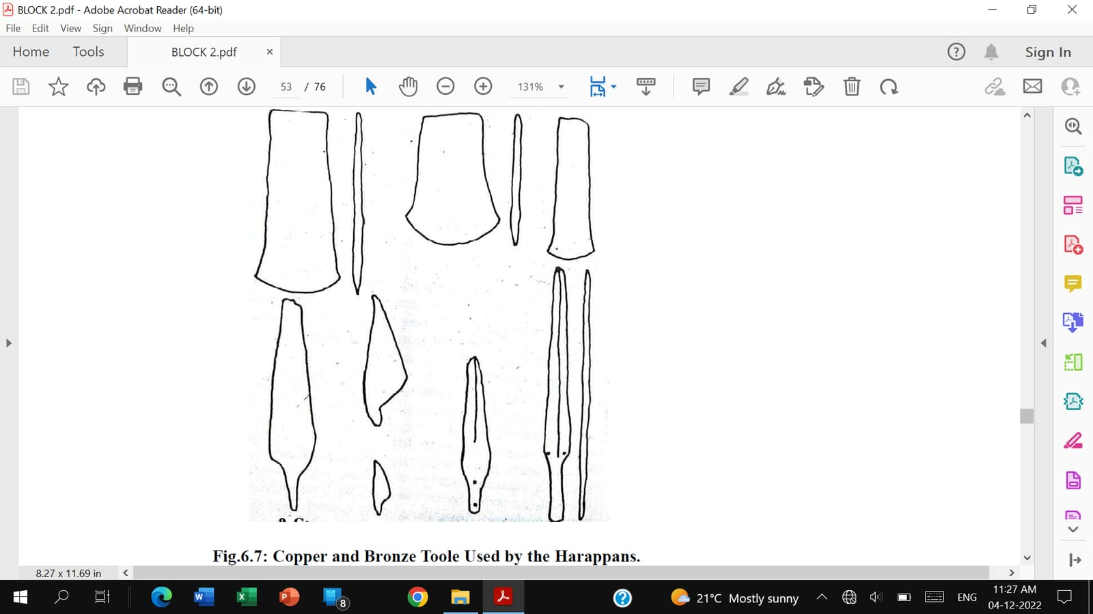
Copper & Bronze Tools: Harappans

Slide 10
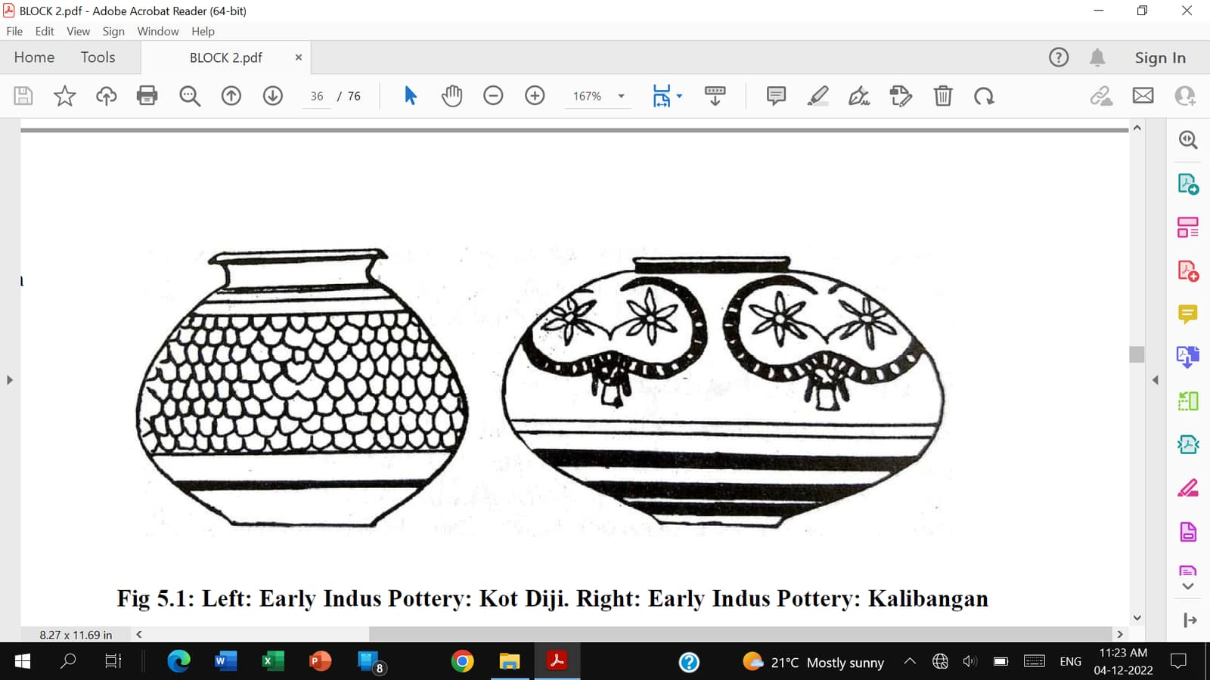
Early Harappan Pottery

Slide 11
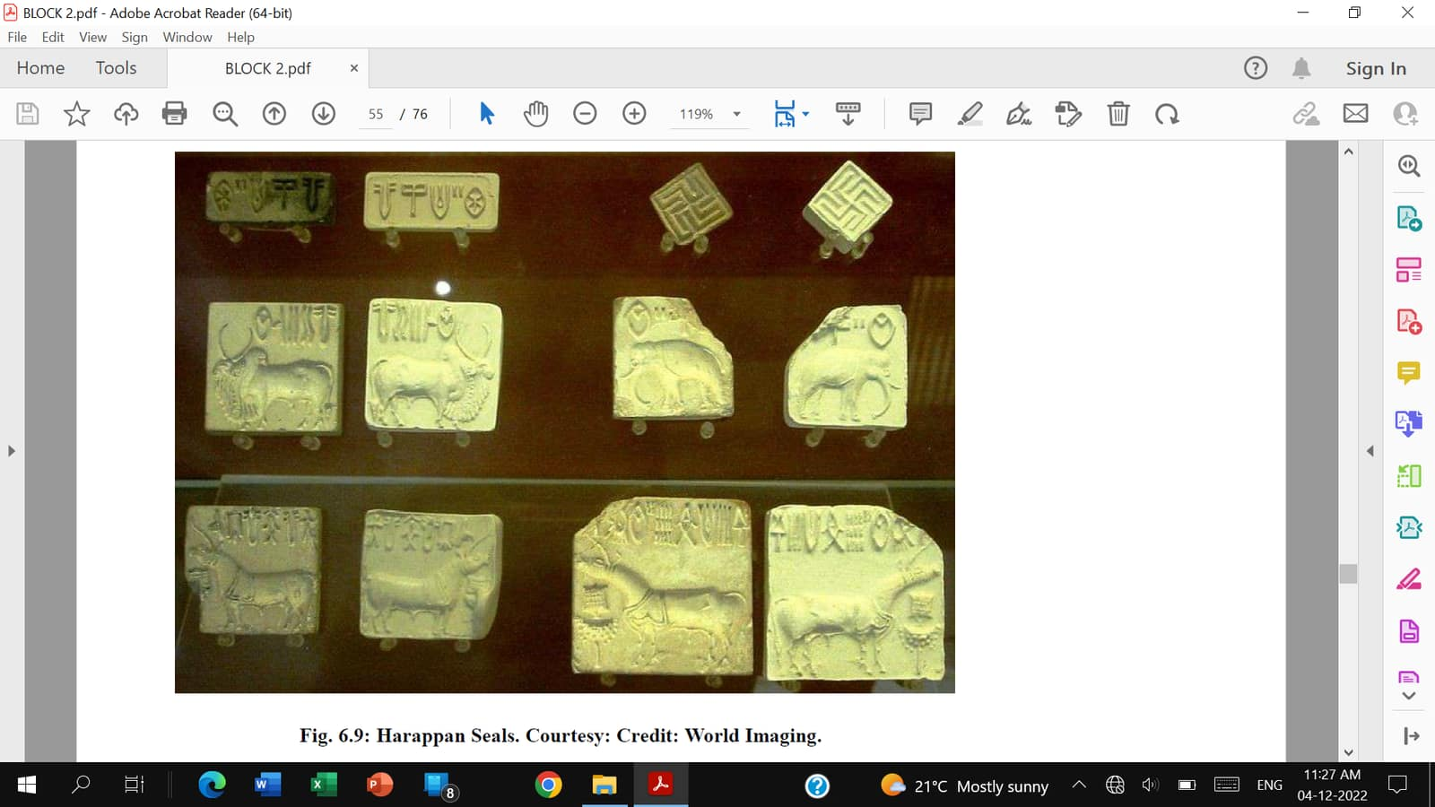
Harappan Seals

Slide 12
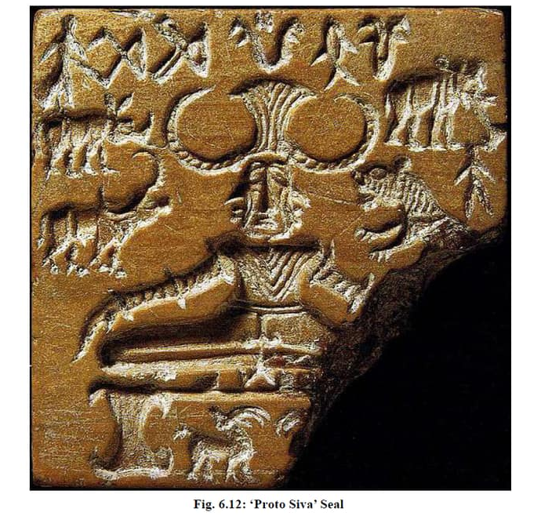
Harappan Proto-Siva Seal

Slide 13
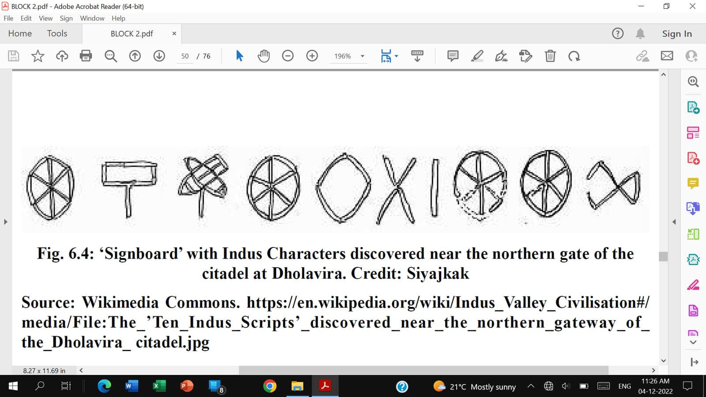
Signboard: Dholavira

Slide 14
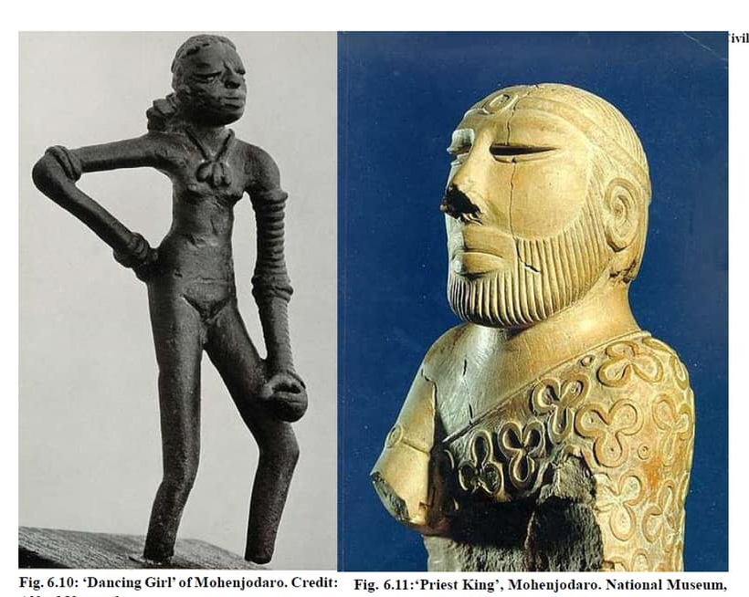
Dancing Girl & Priest King: Mohenjodaro

Slide 15
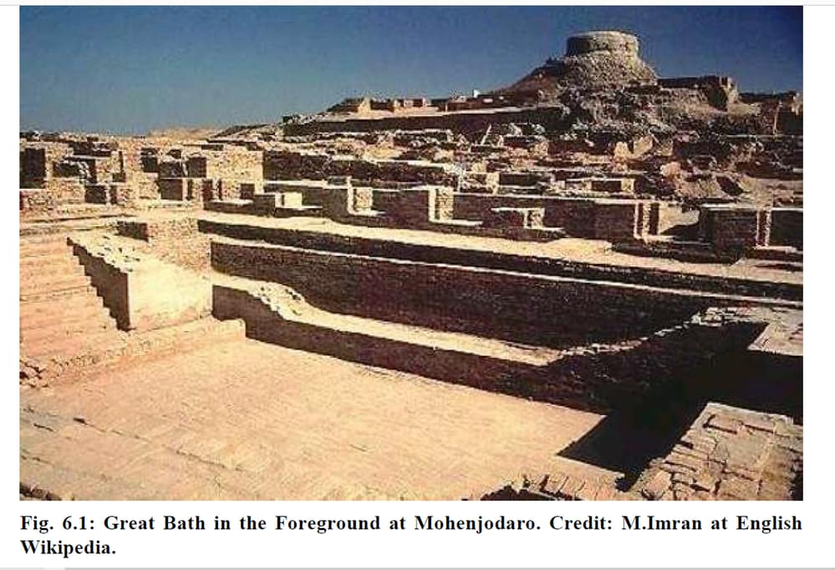
Great Bath: Mohenjodaro

Slide 16
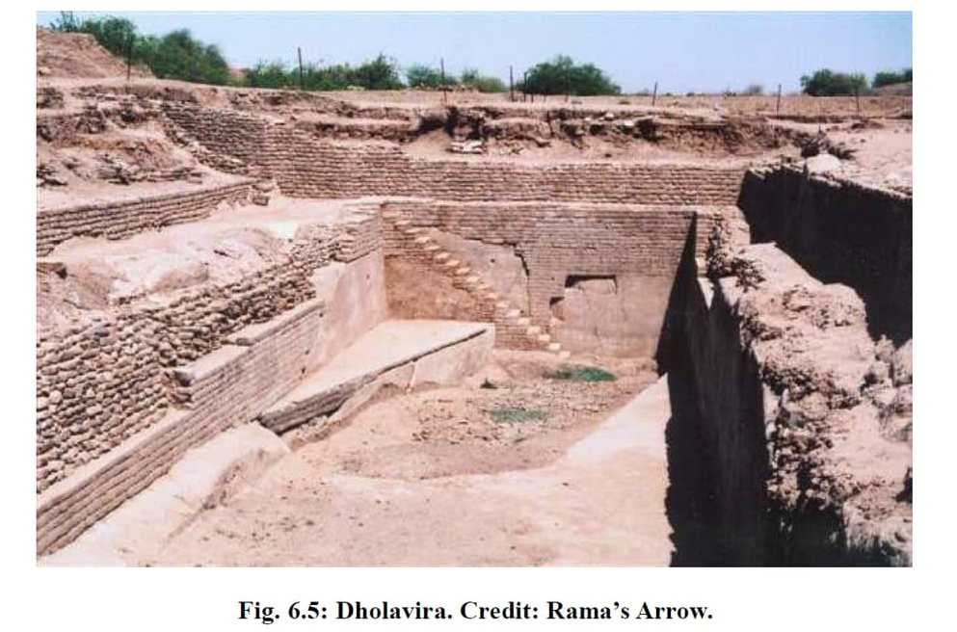
Dholavira

Slide 17
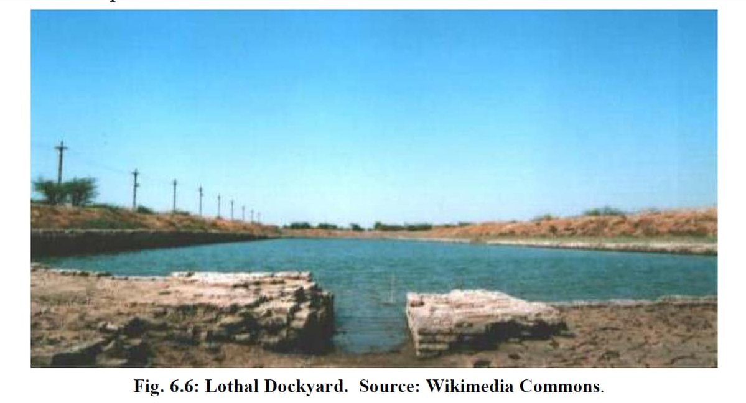
Dockyard: Lothal

Slide 18
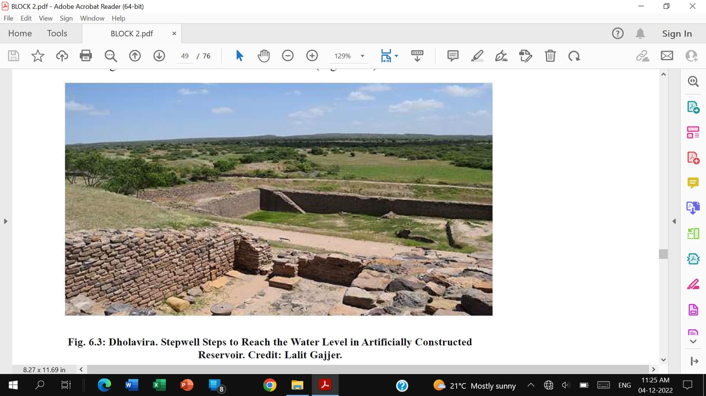
Reservoir: Dholavira

Slide 19
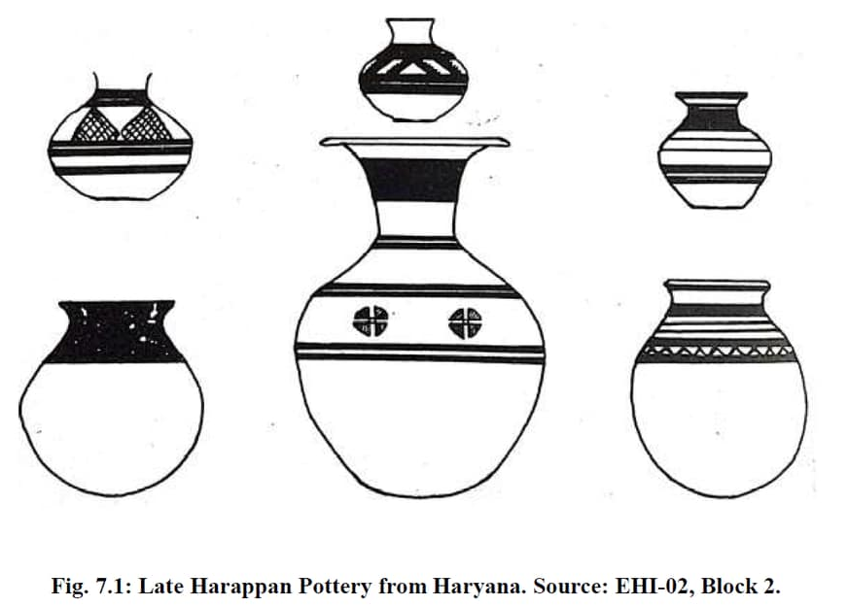
Late Harappan Pottery: Haryana

Slide 20
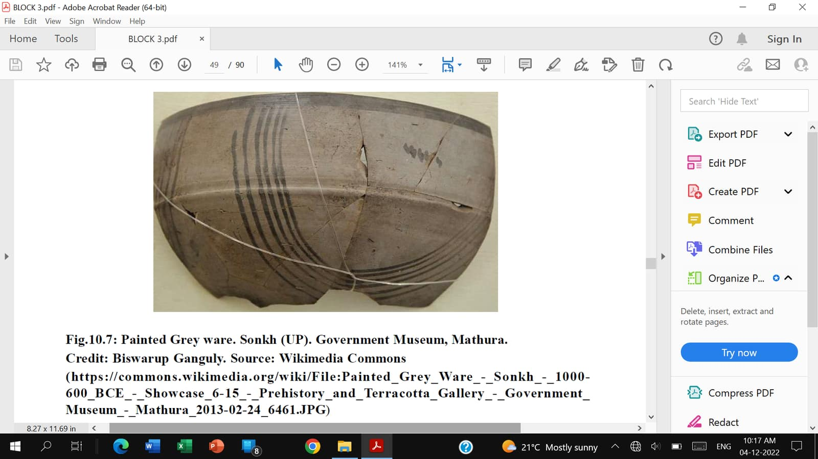
PGW

Slide 21
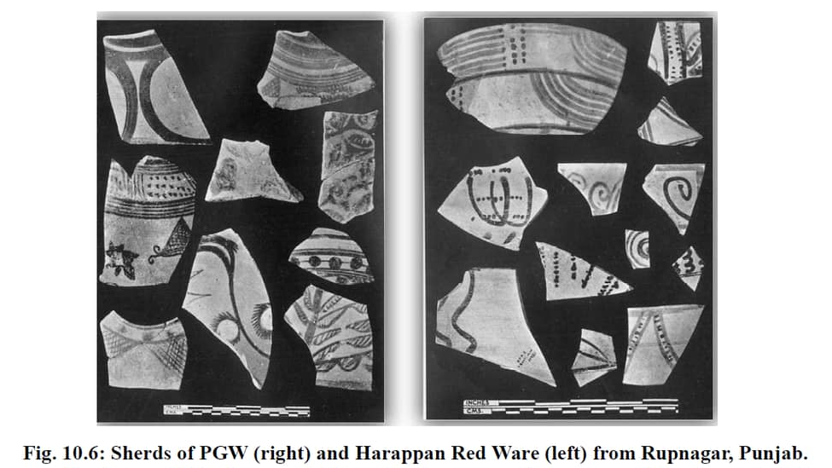
PGW & RW

Slide 22
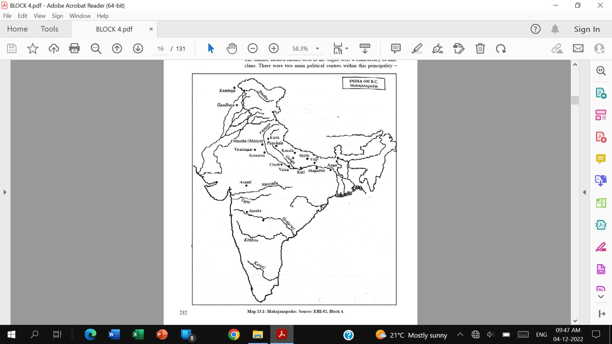
Mahajanapadas

Slide 23
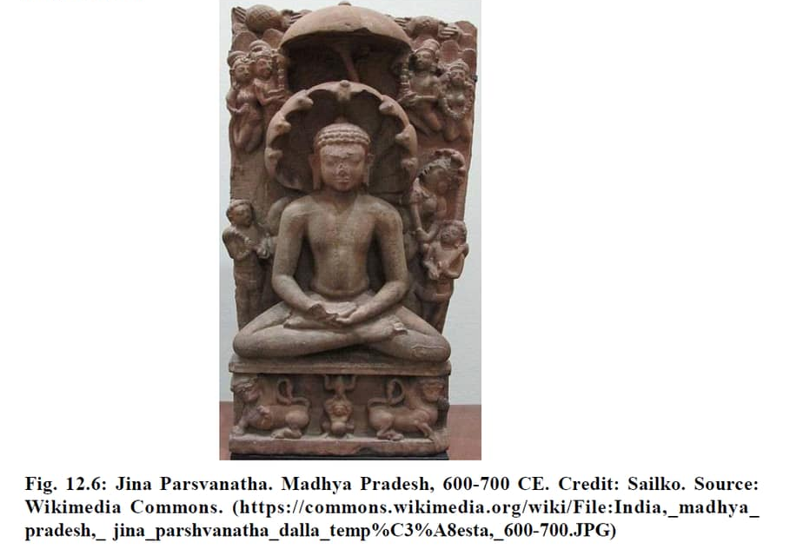
Parsvanatha

Slide 24
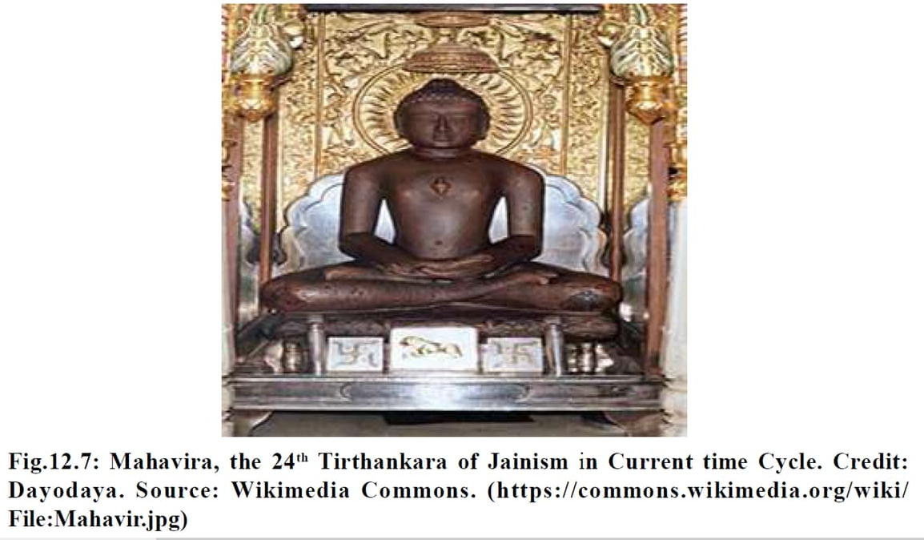
Mahavira

Slide 25
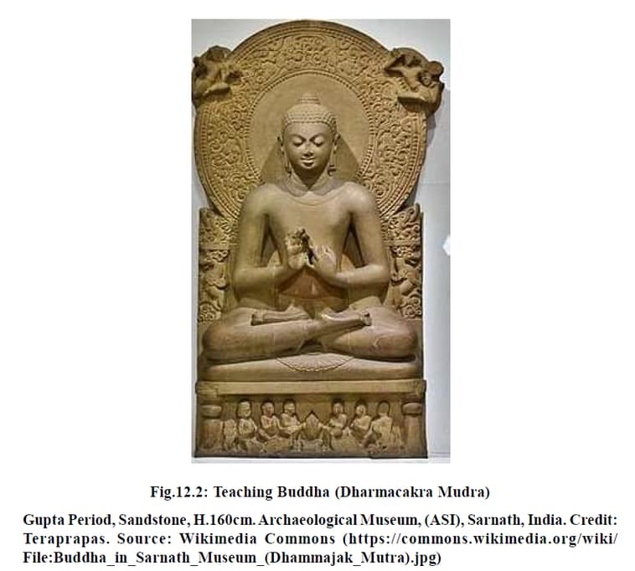
Buddha

Slide 26
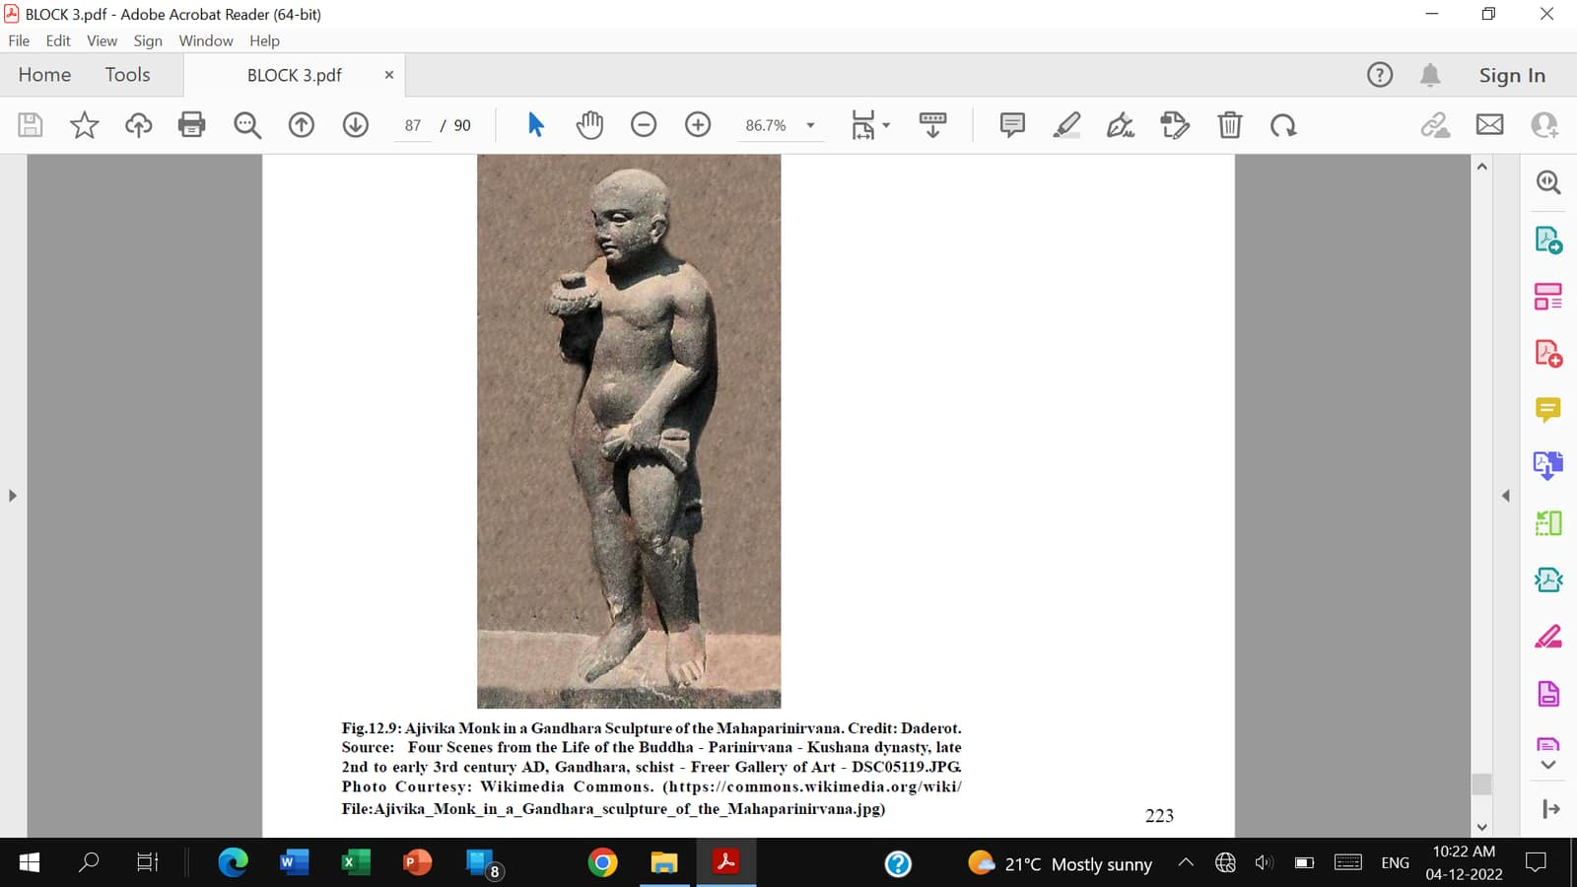
Ajivika Monk: Gandhara

Slide 27
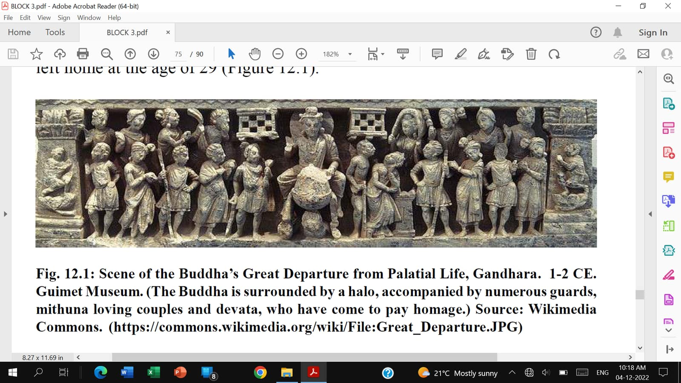
Buddha’s Departure from Home

Slide 28
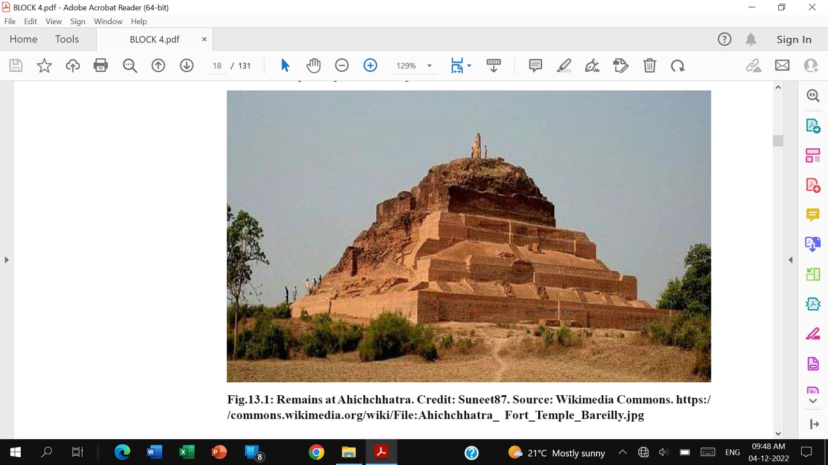
Remains of Ahichchatra

Slide 29
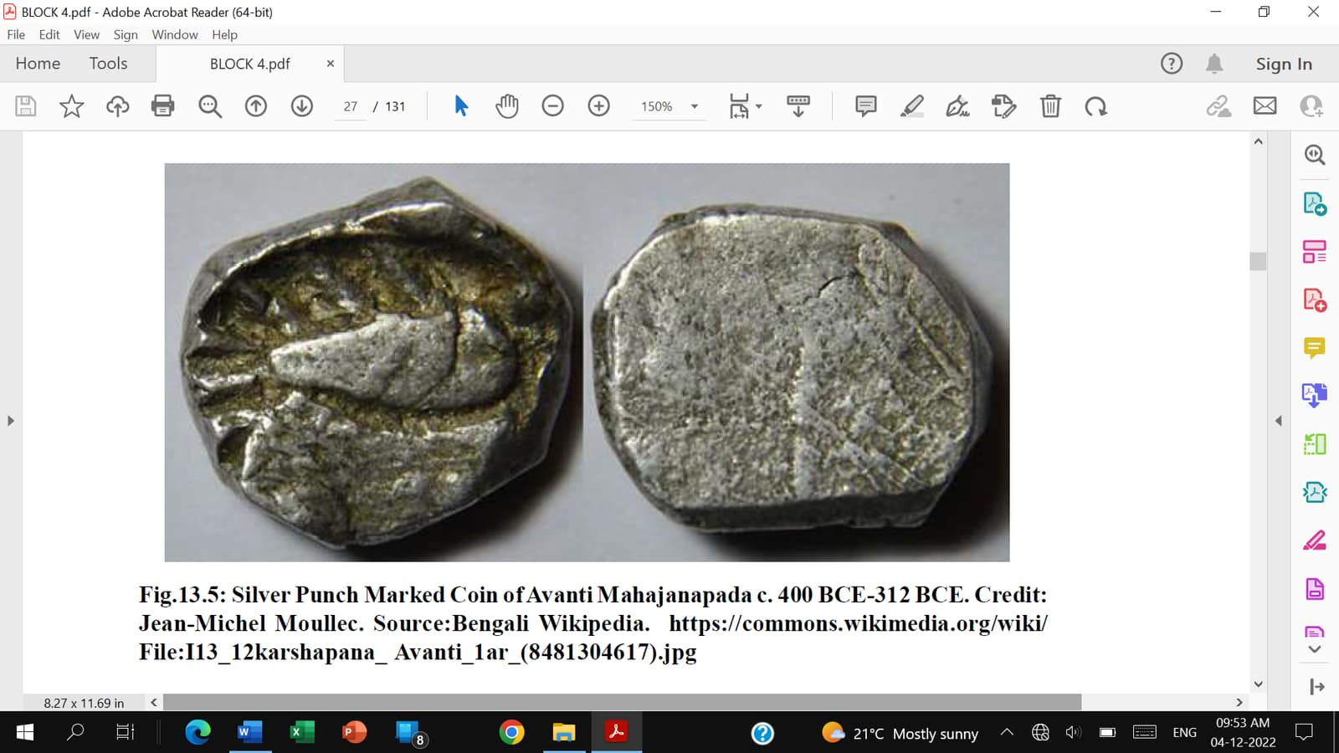
Coins of Avanti

Slide 30
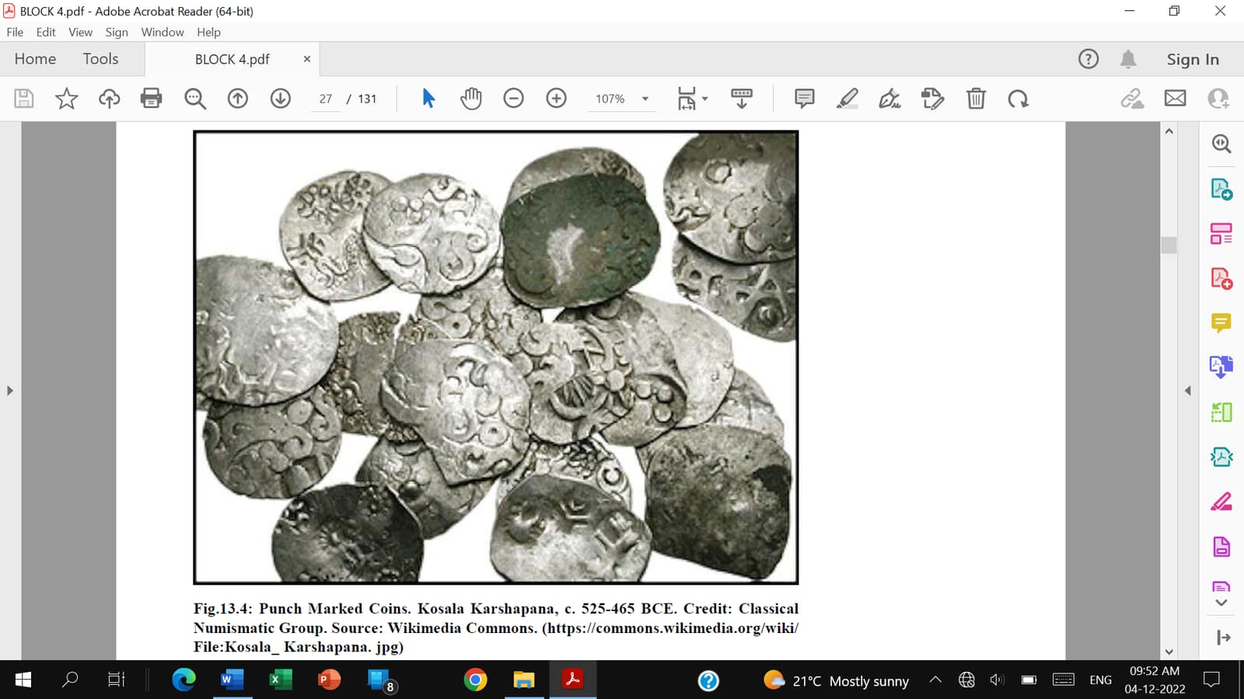
Coins of Koshala

Slide 31
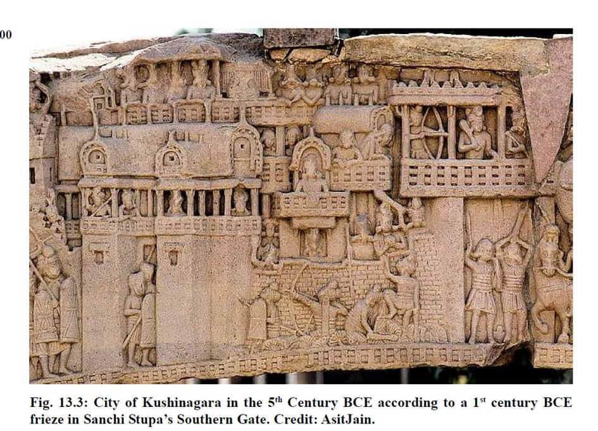
City of Kushinagara

Slide 32
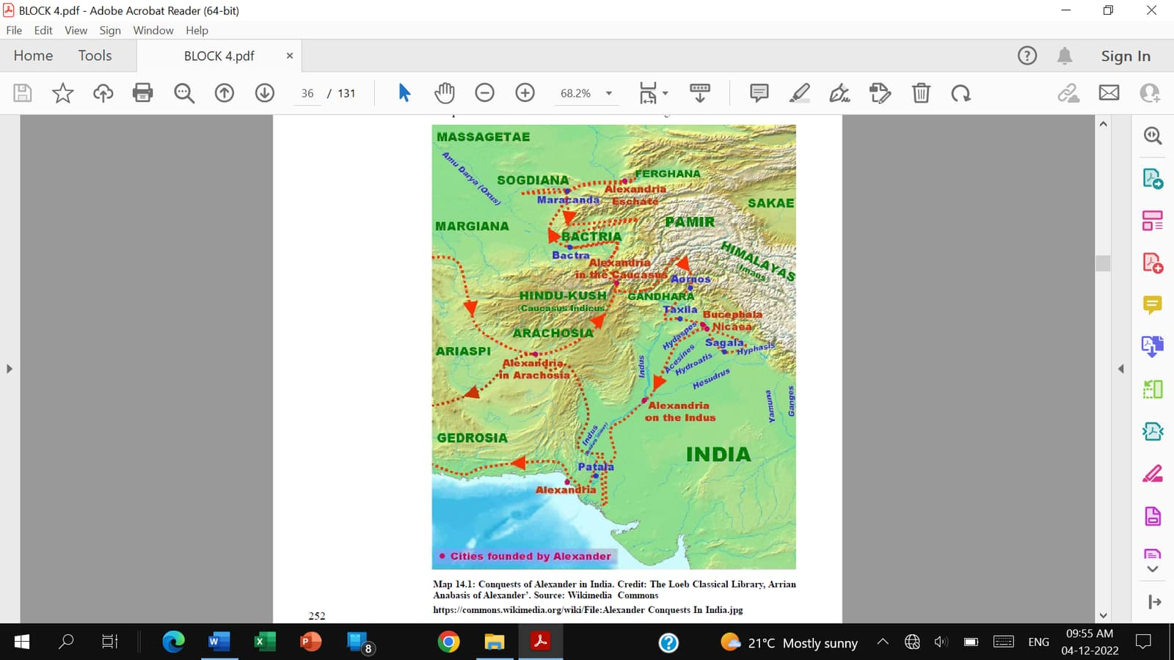
Conquests of Alexander: India

Slide 33
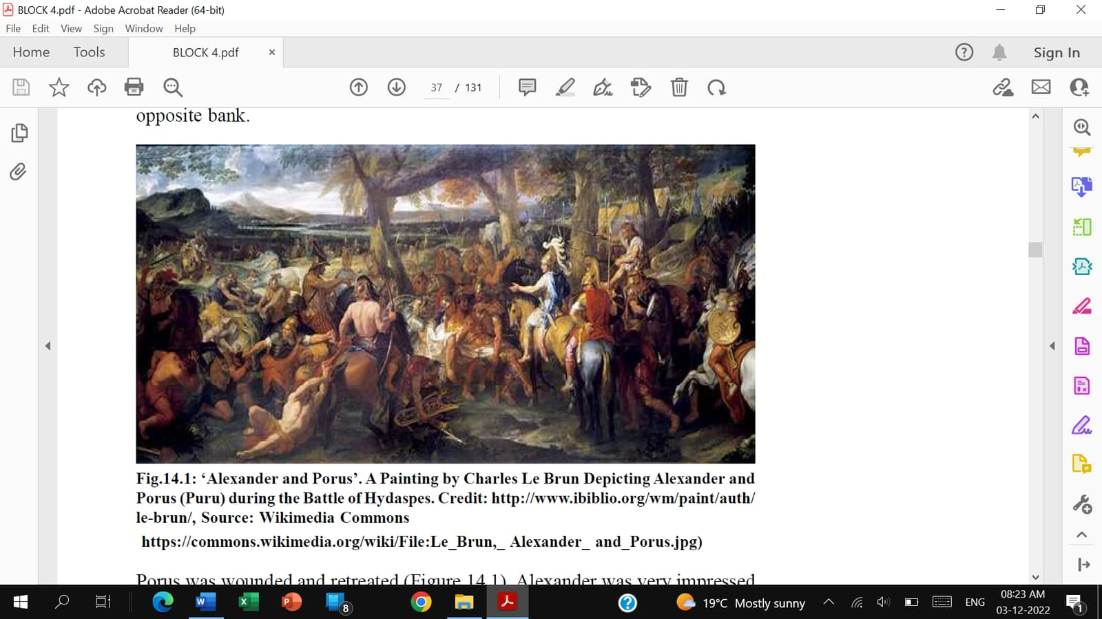
Alexander and Porus: Painting

Slide 34
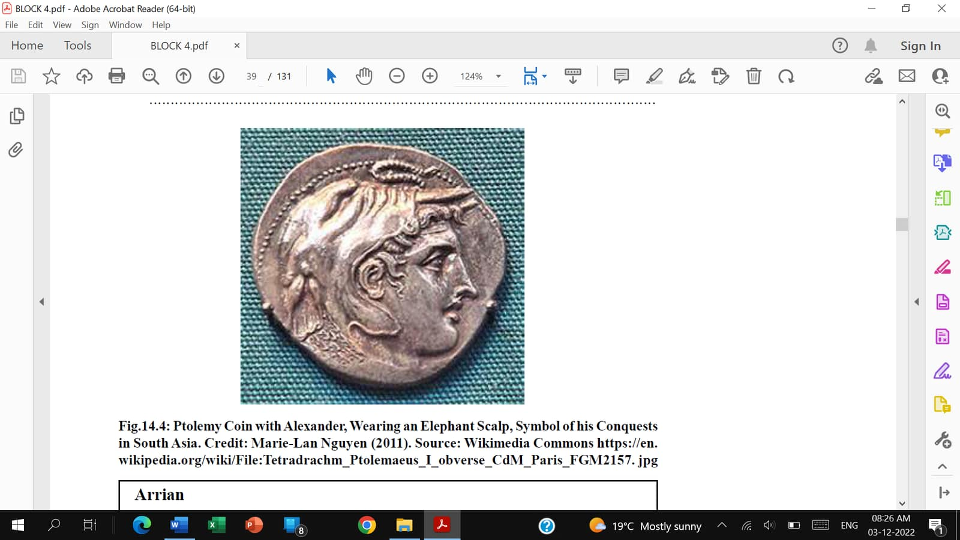
Coin of Alexander

Slide 35
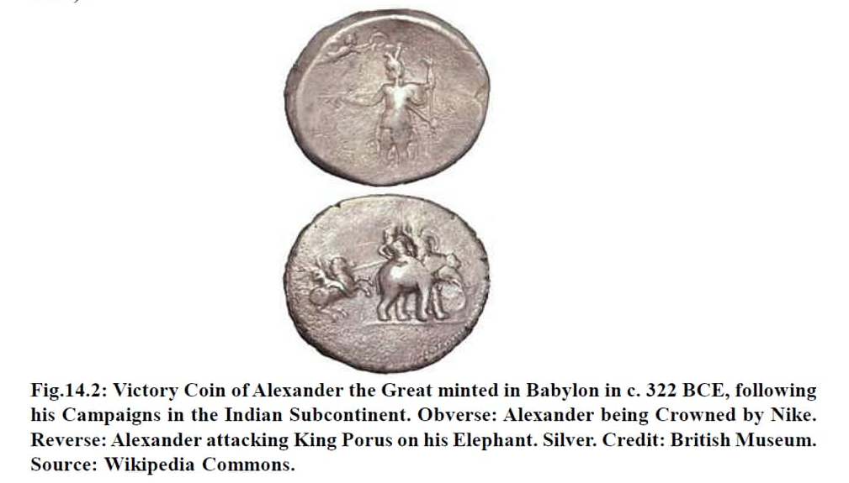
Victory Coin of Alexander

Slide 36
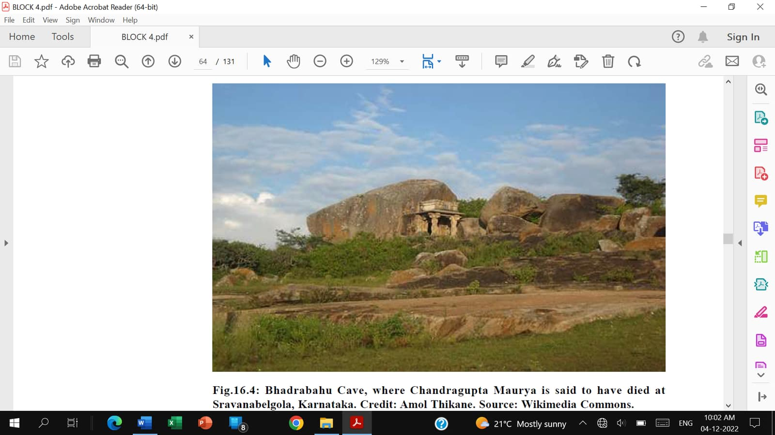
Bhadravahu Cave: Sravanabelgola

Slide 37
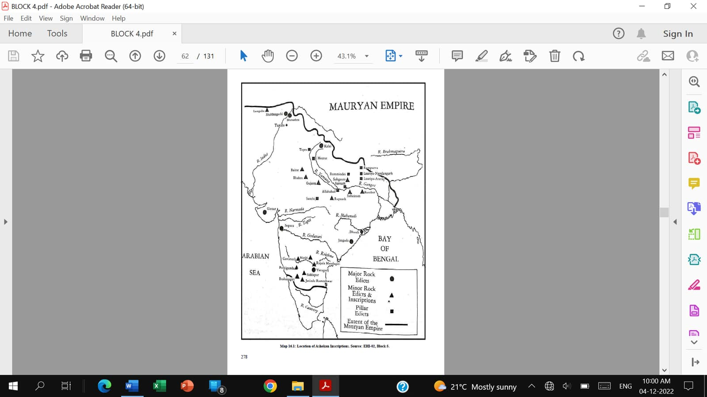
Location of Inscriptions: Ashoka

Slide 38
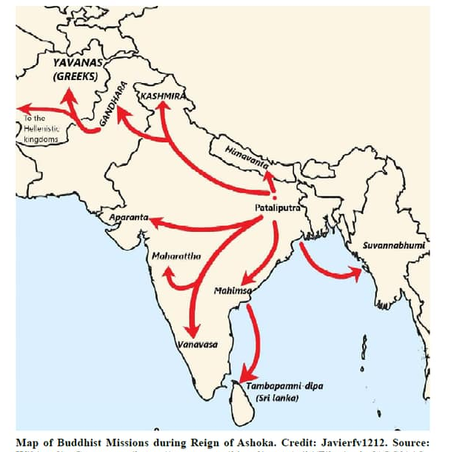
Buddhist Missions of Ashoka

Slide 39
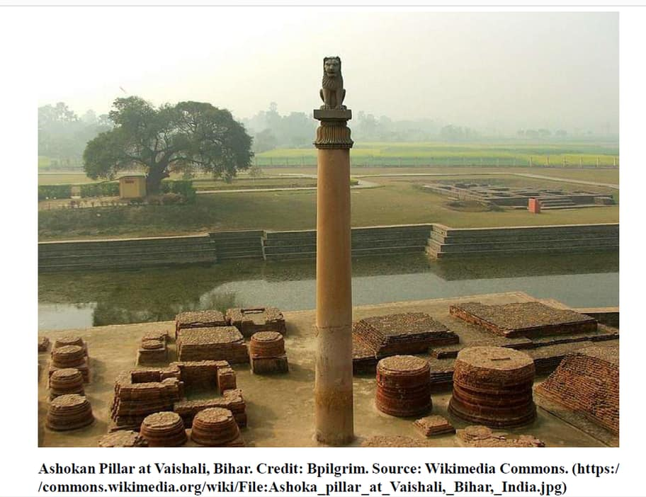
Ashokan Pillar: Vaishali

Slide 40
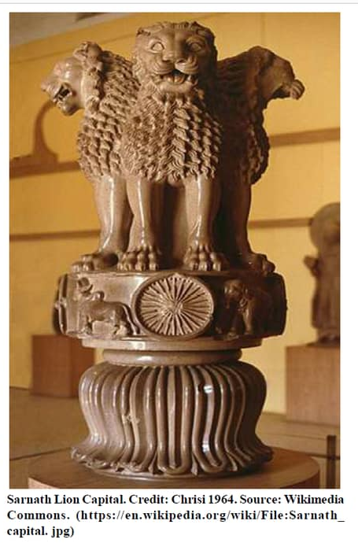
Ashokan Lion Capital: Sarnath

Slide 41
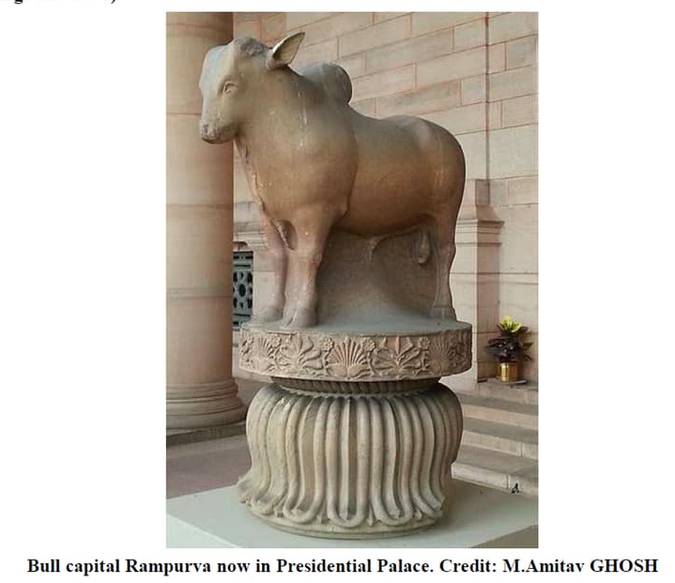
Ashokan Bull Capital: Rampurva

Slide 42
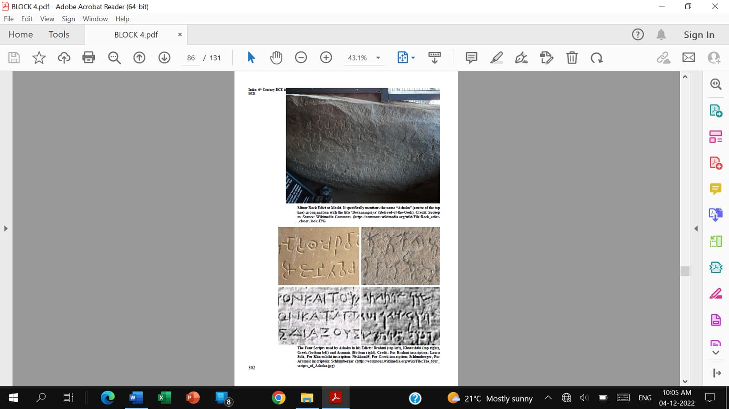
Rock Edicts of Ashoka

Slide 43
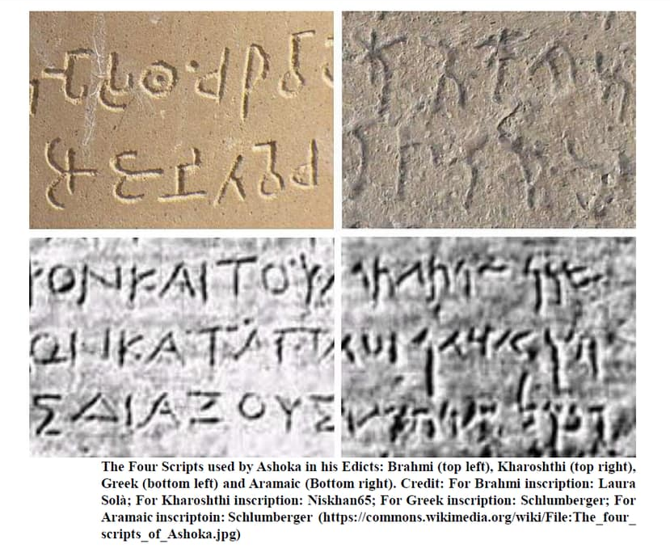
4 Scripts of Ashoka

Slide 44
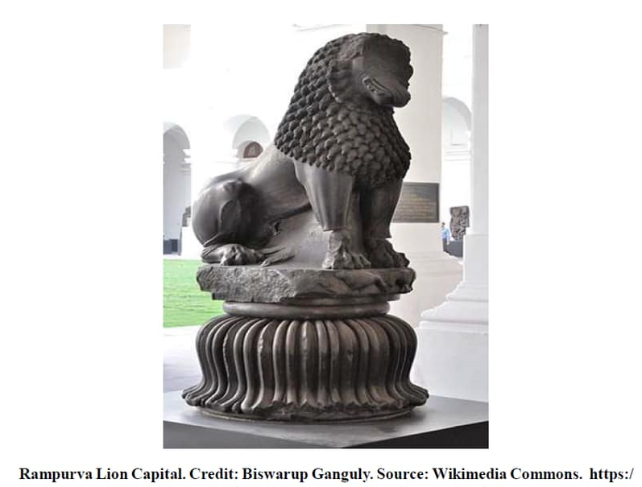
Ashokan Lion Capital: Rampurva

Slide 45
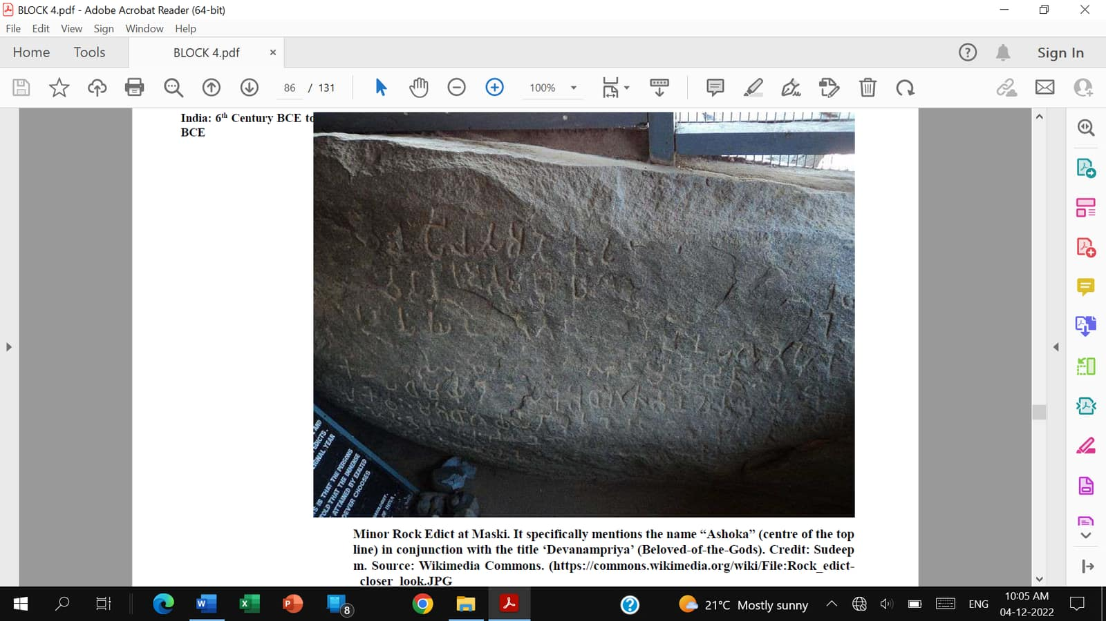
Ashoka’s Minor Rock Edict: Maski

Slide 46
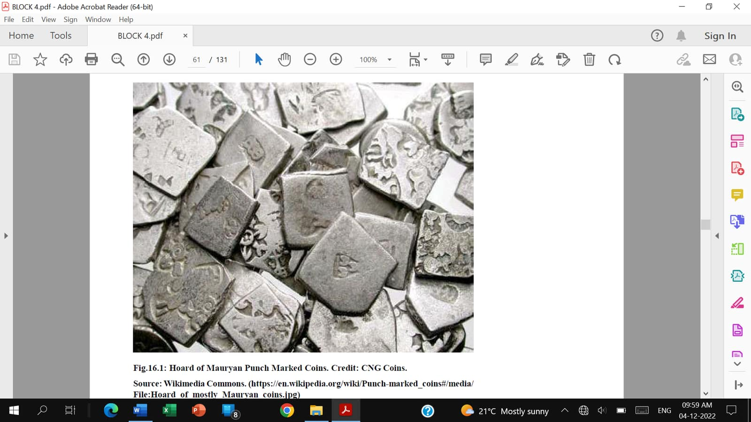
Punch-Marked Coins: Maurya

Slide 47
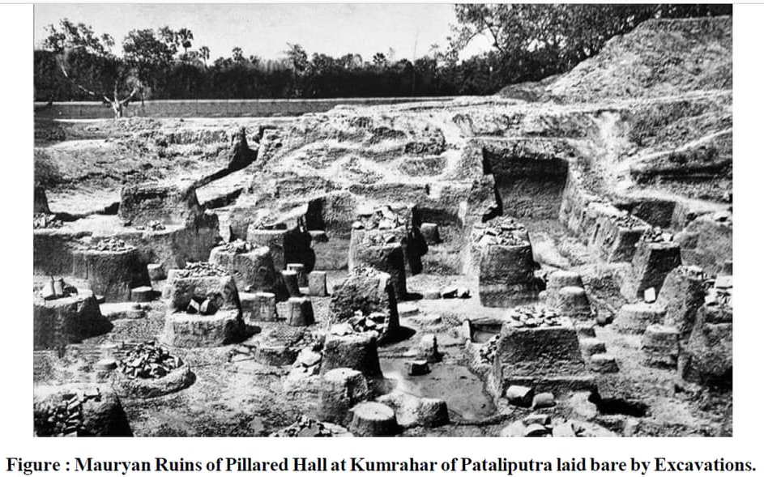
Ruins of Mauryan Capital

Slide 48
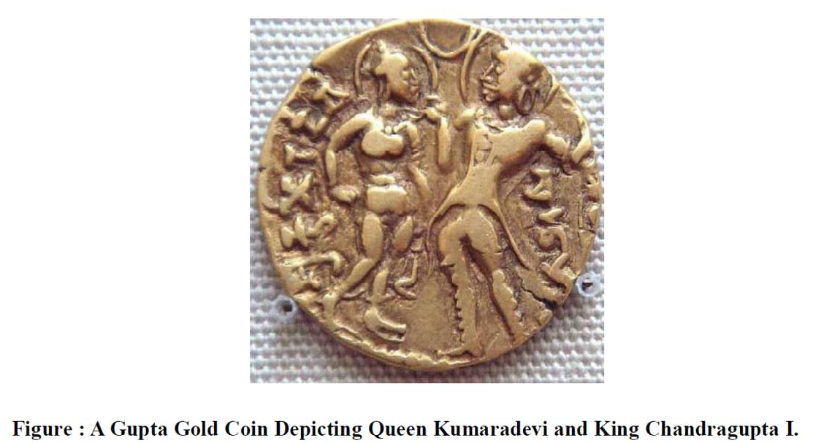
Gupta Gold Coin

Slide 49
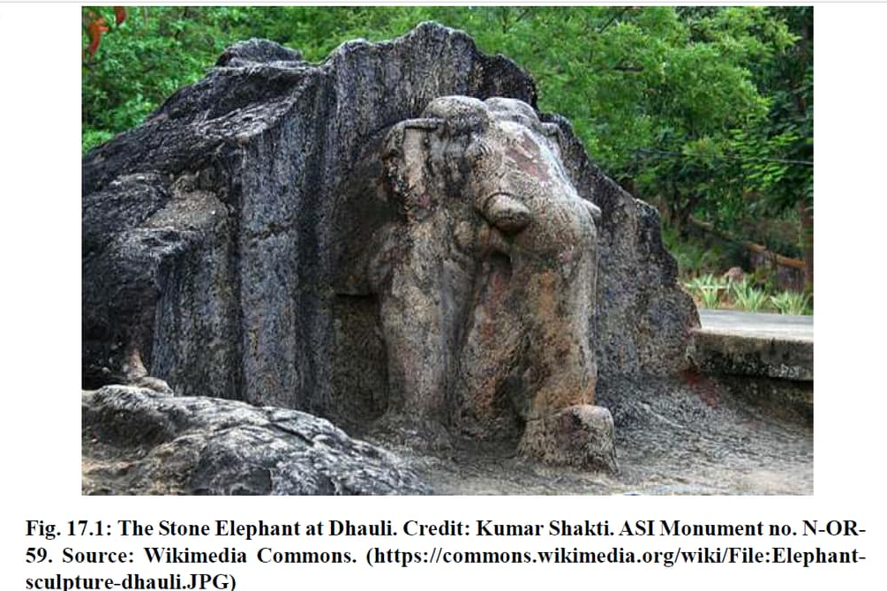
Stone Elephant at Dhauli

