Slide 1
Art & Architecture of Mughal India

Slide 2
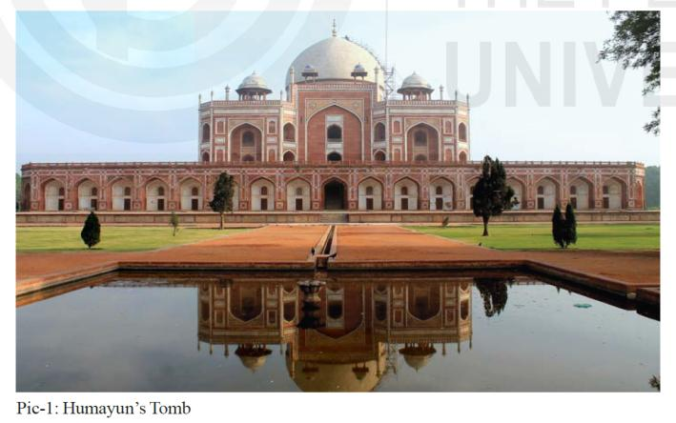
Humayun’s Tomb

Slide 3
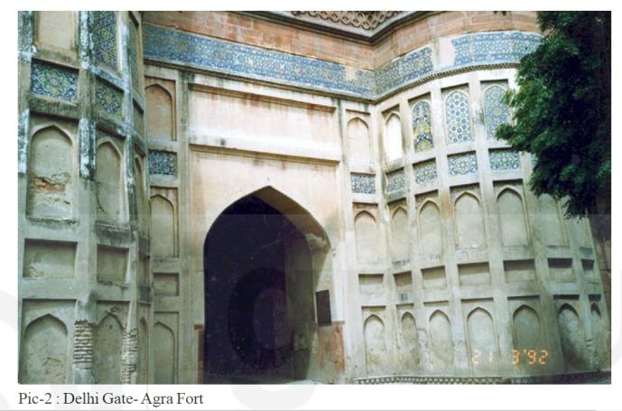
Delhi Gate: Agra Fort

Slide 4
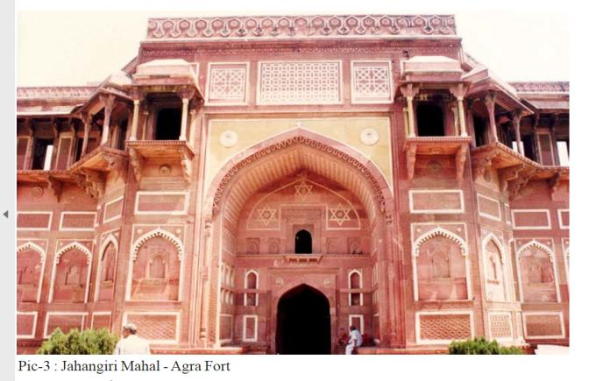
Jahangiri Mahal: Agra Fort

Slide 5
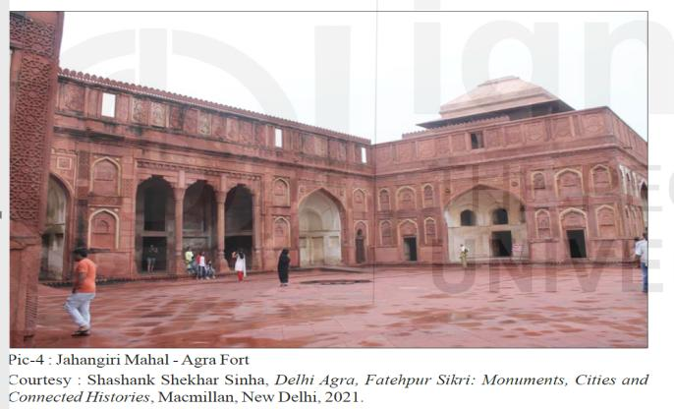
Jahangiri Mahal: Agra Fort

Slide 6
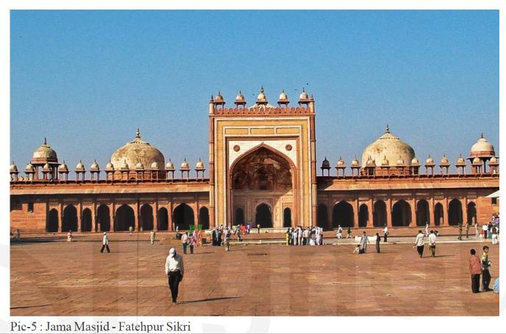
Jama Mosque: Fatehpur Sikri

Slide 7
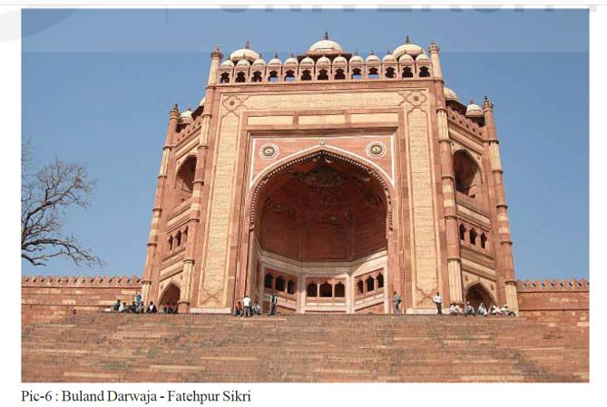
Buland Darwaja: Fatehpur Sikri

Slide 8
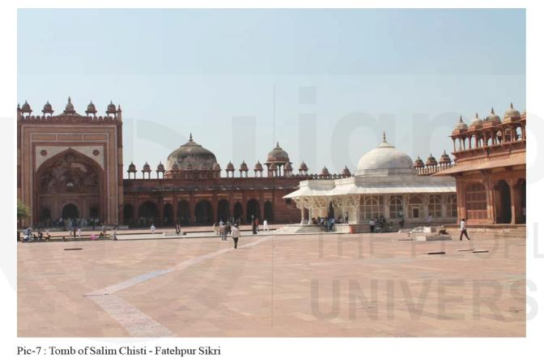
Tomb of Salim Chisti: Fatehpur Sikri

Slide 9
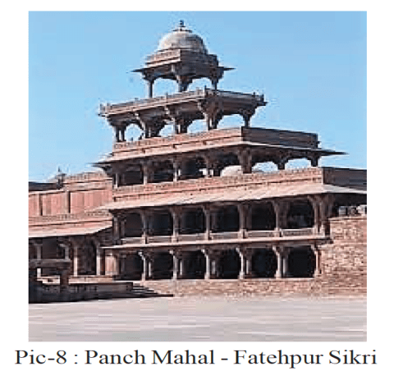
Panch Mahal: Fatehpur Sikri

Slide 10
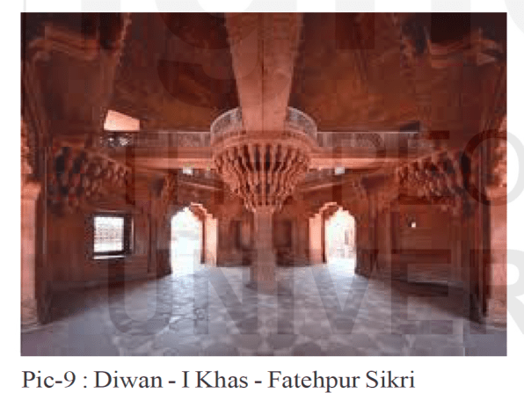
Diwan-i-Khas: Fatehpur Sikri

Slide 11
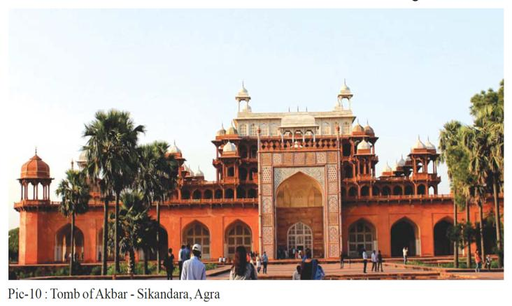
Tomb of Akbar: Sikandara

Slide 12
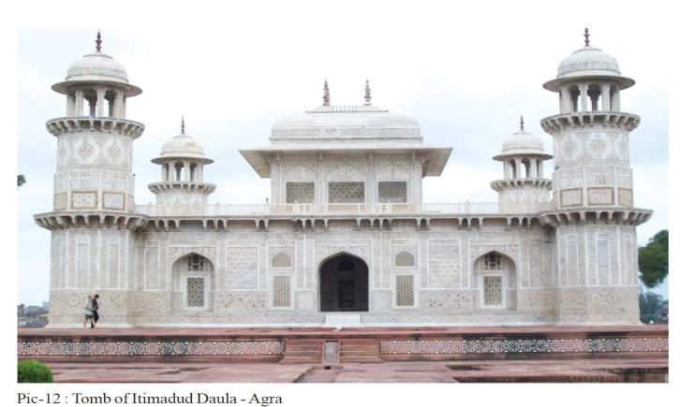
Tomb of Itimad-ud-Daula: Agra

Slide 13
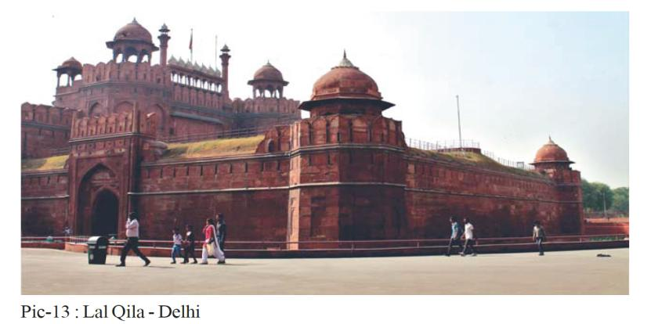
Red Fort: Delhi

Slide 14
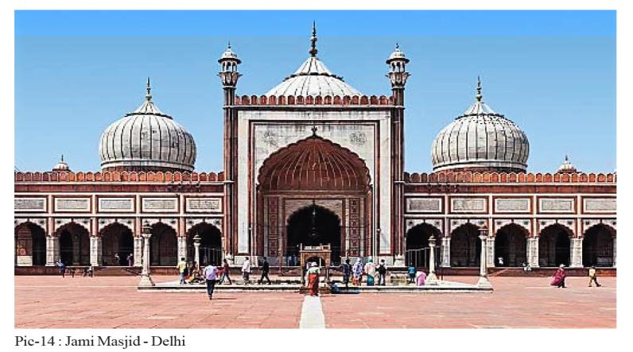
Jama Mosque: Delhi

Slide 15
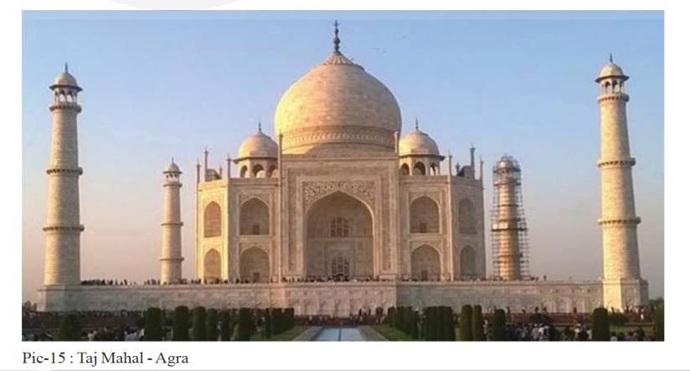
Taj Mahal: Agra

Slide 16
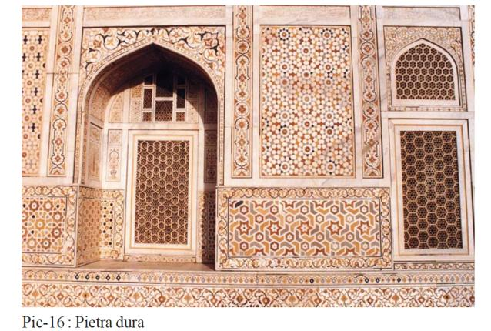
Pietra Dura: Taj Mahal

Slide 17
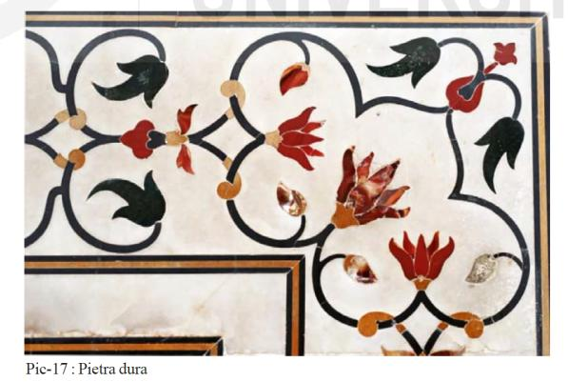
Pietra Dura: Itimad-ud-Daula’s Tomb

Slide 18
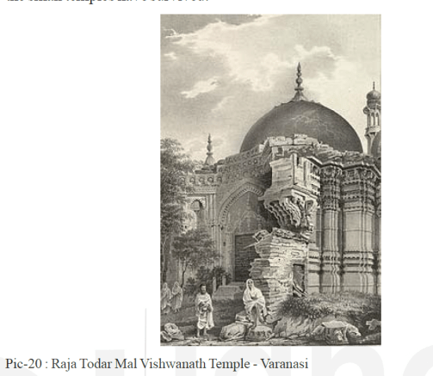
Vishwanath Temple: Varanasi

Slide 19
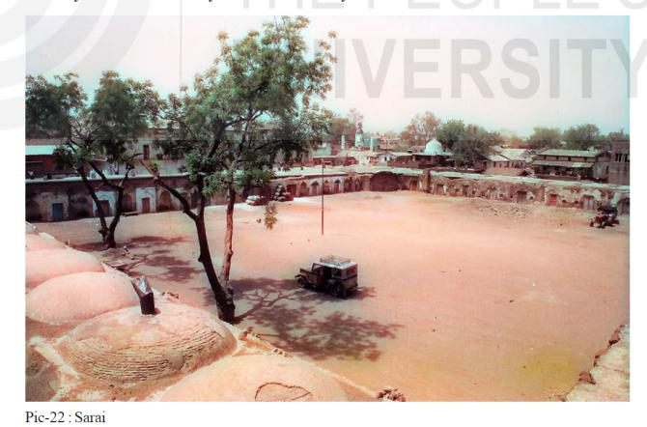
Sarai

Slide 20
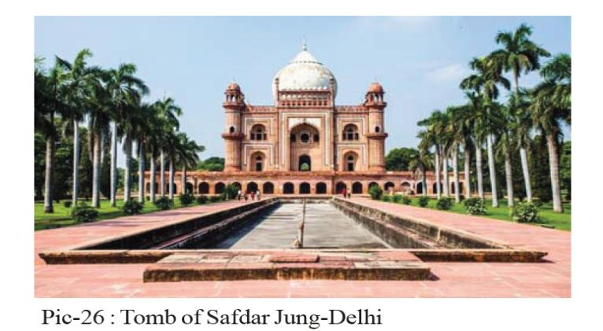
Safdar Jung’s Tomb: Delhi

Slide 21
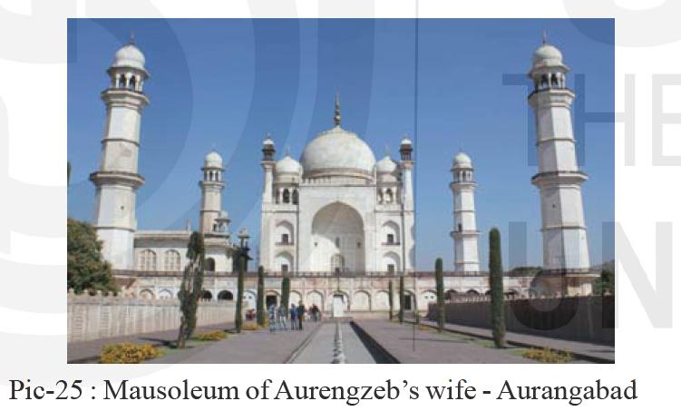
Bibi ka Makbara: Aurangabad

Slide 22
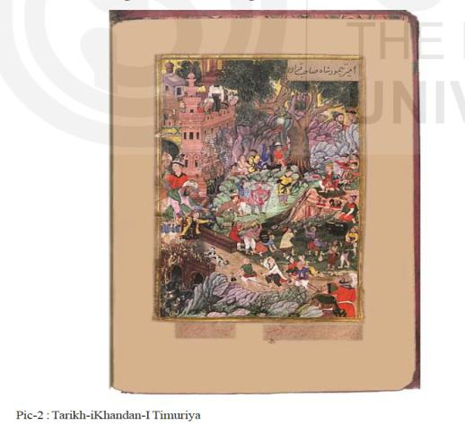
Tarikh-i-Khandan-i-Timuriya

Slide 23
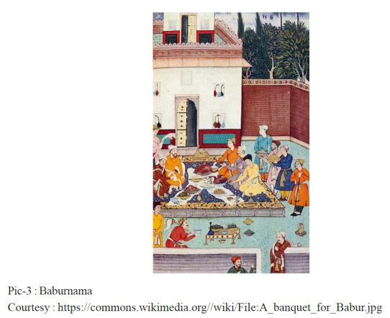
Illustration: Baburnama

Slide 24
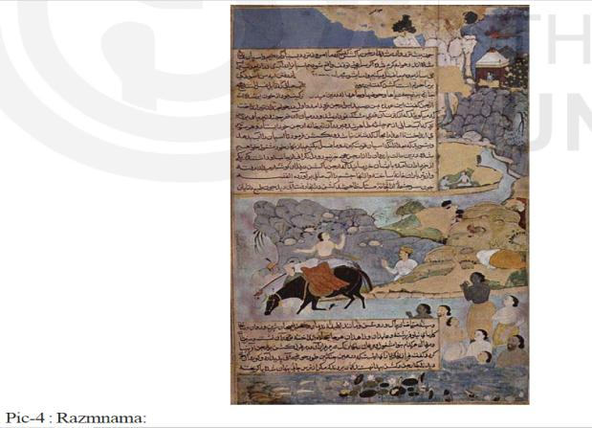
Razmnama

Slide 25
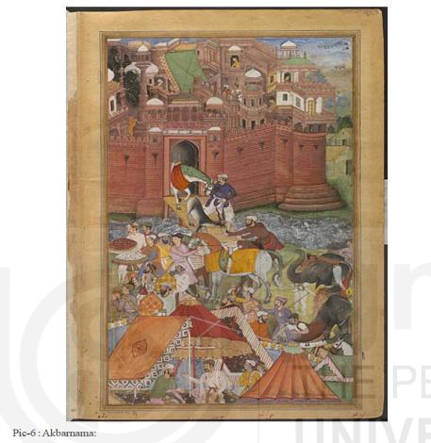
Illustration: Akbar Nama

Slide 26
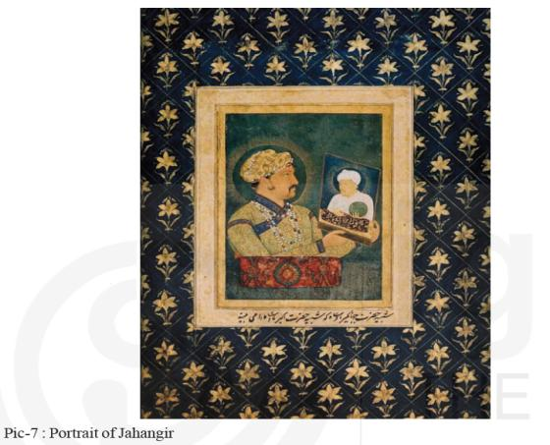
Portrait of Jahangir

Slide 27
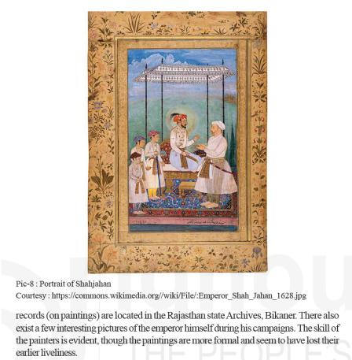
Portrait of Shahjahan

Slide 28
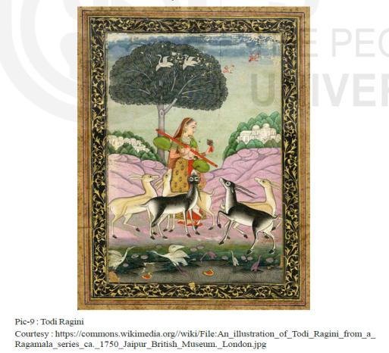
Todi Ragini

Slide 29
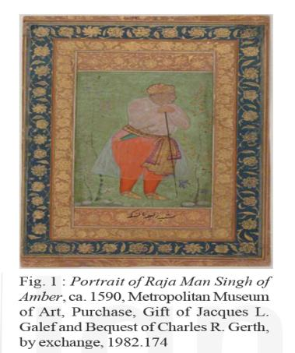
Portrait of Man Singh

Slide 30
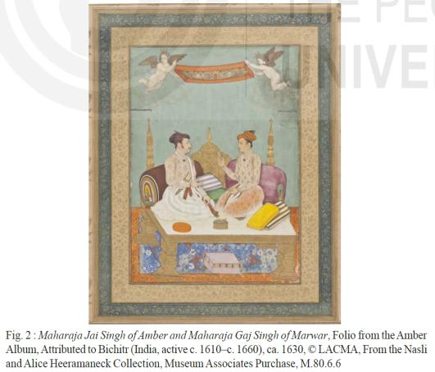
Portrait of Jai Singh

Slide 31
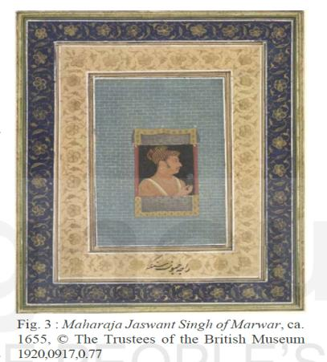
Portrait of Jaswant Singh

Slide 32
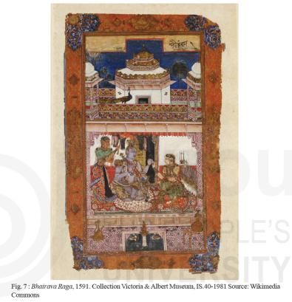
Bhairava Raga

Slide 33
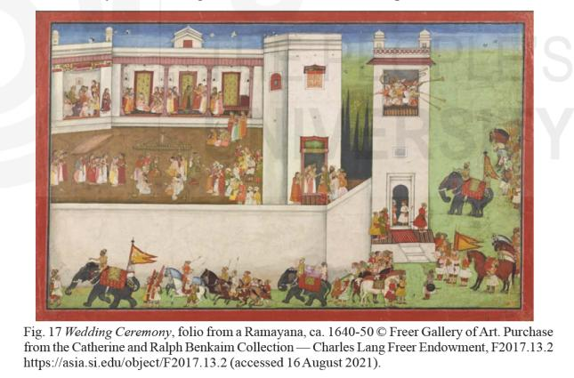
Wedding Ceremony: Ramayana

Slide 34
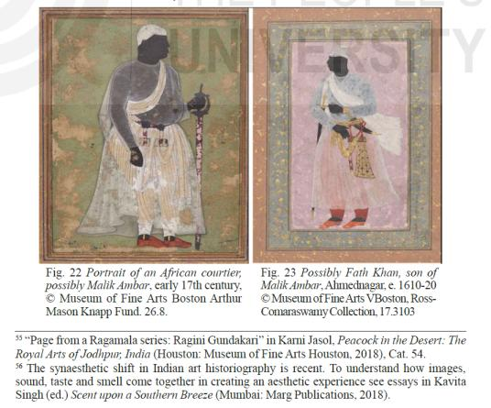
Portrait of Malik Ambar

Slide 35
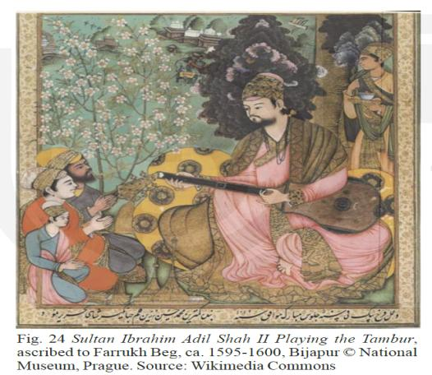
Portrait of Ibrahim Adil Shah II

Slide 36
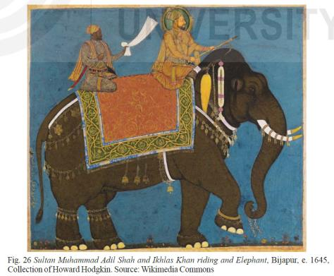
Portrait of Mohammad Adil Shah

Slide 37
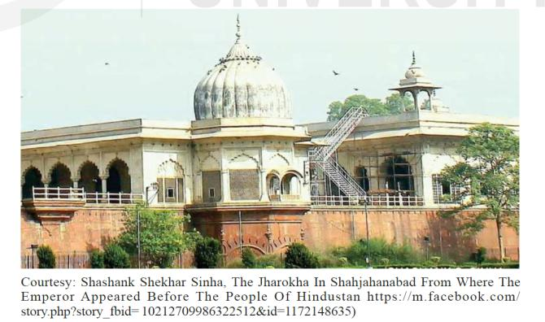
Jharokha Darshan

Slide 38
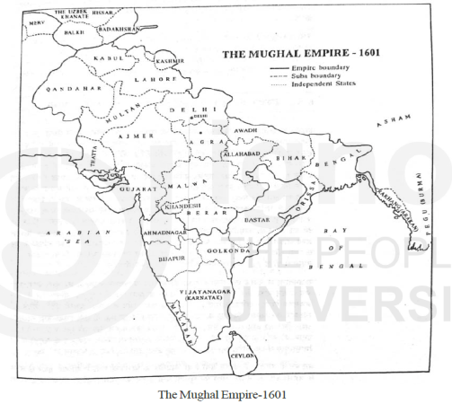
Mughal Empire: 1601

Slide 39
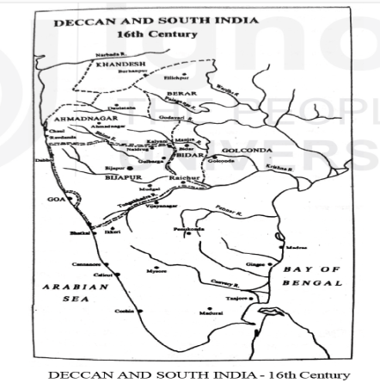
Deccan and South India: 16th Century

Slide 40
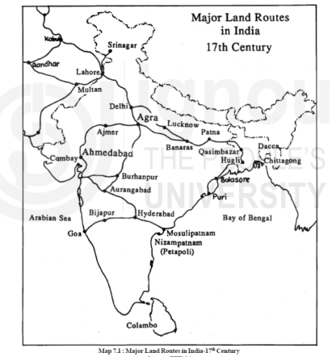
Major Land Routes: 17th Century India

Slide 41
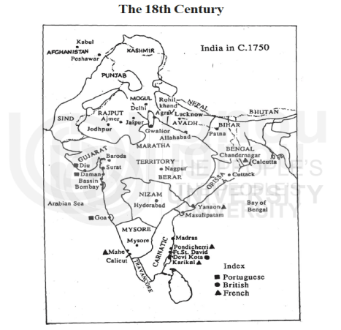
India in 1750 AD

